Slide 1

Welcome CT Basketball Officials
2021-2022 NFHS Rule Changes and Points of Emphasis
Notes:
NATIONAL FEDERATION OF STATE HIGH SCHOOL ASSOCIATIONS

Slide 2
> 21-22 Rules/Points of Emphasis > CT Concussion Management > CT Adopted Mechanics
Agenda
Notes:
NATIONAL FEDERATION OF STATE HIGH SCHOOL ASSOCIATIONS

Slide 3
General Information
2021-2022 NFHS Rule Changes
Notes:
NATIONAL FEDERATION OF STATE HIGH SCHOOL ASSOCIATIONS

Slide 4
2021-2022 NFHS Rules Changes & Points of Emphasis
Notes:
Q-COLLAR
The FDA has authorized marketing of a new device intended to be worn around the neck of athletes aged 13 years and older during sports activities to aid in the protection of the brain from the potential effects associated with repetitive sub-concussive head impacts. The non-invasive device is called the Q-Collar.
From a medical perspective, the NFHS SMAC consents to this device being worn by interscholastic athletes.
The respective NFHS Rules Committees will determine if the Q-Collar will be permissible based on sport-by-sport
risk assessments. Basketball does not have a rule that prohibits the wearing of the Q-Collar during competition, therefore, it is permissible to wear during
competition.

Slide 5
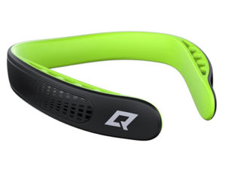
Q-collar
The FDA has authorized marketing of a new device intended to be worn around the neck of athletes aged 13 years and older during sports activities to aid in the protection of the brain from the potential effects associated with repetitive sub-concussive head impacts. The non-invasive device is called the Q-Collar.
From a medical perspective, the NFHS SMAC consents to this device being worn by interscholastic athletes.
The respective NFHS Rules Committees will determine
if the Q-Collar will be permissible based on sport-by-sport
risk assessments. Basketball does not have a rule that
prohibits the wearing of the Q-Collar during competition,
therefore, it is permissible to wear during competition.
Notes:
Q-COLLAR
The FDA has authorized marketing of a new device intended to be worn around the neck of athletes aged 13 years and older during sports activities to aid in the protection of the brain from the potential effects associated with repetitive sub-concussive head impacts. The non-invasive device is called the Q-Collar.
From a medical perspective, the NFHS SMAC consents to this device being worn by interscholastic athletes.
The respective NFHS Rules Committees will determine if the Q-Collar will be permissible based on sport-by-sport
risk assessments. Basketball does not have a rule that prohibits the wearing of the Q-Collar during competition, therefore, it is permissible to wear during
competition.

Slide 6

VISITING team jerseys gray color spectrum chart
Effective with the beginning of the 2021 Basketball Season, the color gray and/or any other light colors being used for an away jersey, must meet the 70% shading of the main color being used in the jersey in order for it to clearly contrast with white.
100% 90% 80% 70% 60% 50% 40% 30% 20% 10% 0%
Notes:
VISITING TEAM JERSEYS – GRAY COLOR SPECTRUM CHART
Effective with the beginning of the 2021 Basketball Season, the color gray and/or any other light colors being used for an away jersey, must meet the 70% shading of the main color being used in the jersey in order for it to clearly contrast with white.

Slide 7
2021-2022 NFHS Rule Changes
Notes:
NATIONAL FEDERATION OF STATE HIGH SCHOOL ASSOCIATIONS

Slide 8
2-14 (NEW) SHOT CLOCK
By state association adoption, effective with the 2022-2023 season, member state associations may establish a shot clock in which the team in control shall attempt a try for field goal within 35 seconds after gaining team control.
ART. 1 This shall be regulated by a visible shot clock.
ART. 2 The tap or try for field goal shall leave the shooter's hand before the expiration of time and subsequently strike the basket ring or enter the basket before or after the shot clock period has expired.
Notes:
2-14 (NEW)
By state association adoption, effective with the 2022-2023 season, member state associations may establish a shot clock in which the team in control shall attempt a try for field goal within 35 seconds after gaining team control.
ART. 1 This shall be regulated by a visible shot clock.
ART. 2 The tap or try for field goal shall leave the shooter's hand before the expiration of time and subsequently strike the basket ring or enter the basket before or after the shot clock period has expired.

Slide 9
SHOT CLOCK
Shot clock regulations as printed in the 2021-22 Basketball Rules Book must be followed to be in compliance with NFHS rules.
Notes:
SHOT CLOCK
Shot clock regulations as printed in the 2021-22 Basketball Rules Book must be followed to be in compliance with NFHS rules.

Slide 10
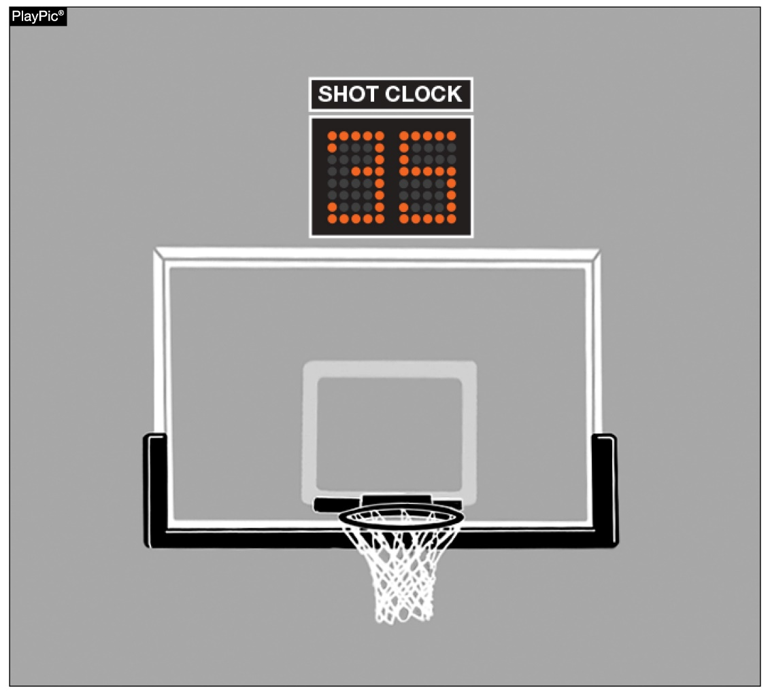
2-14 (NEW) shot clock STATE ADOPTION 2022-23
NFHS permits state association adoption of the shot clock, effective with the 2022-23 season.
Notes:
2-14 (NEW) SHOT CLOCK STATE ADOPTION 2022-23
NFHS permits state association adoption of the shot clock, effective with the 2022-23 season.

Slide 11
3-5-4e (NEW) HEAD COVERINGS FOR RELIGIOUS REASONS
Head coverings worn for religious reasons shall not be made of abrasive or hard materials; and must fit securely so that they are highly unlikely to come off during play.
NOTE: The State Association shall be notified, after the contest, if there is a concern about a head covering worn for religious reasons.
Notes:
3-5-4e (NEW) HEAD COVERINGS FOR RELIGIOUS REASONS
Head coverings worn for religious reasons shall not be made of abrasive or hard materials; and must fit securely so that they are highly unlikely to come off during play.
NOTE: The State Association shall be notified, after the contest, if there is a concern about a head covering worn for religious reasons.

Slide 12
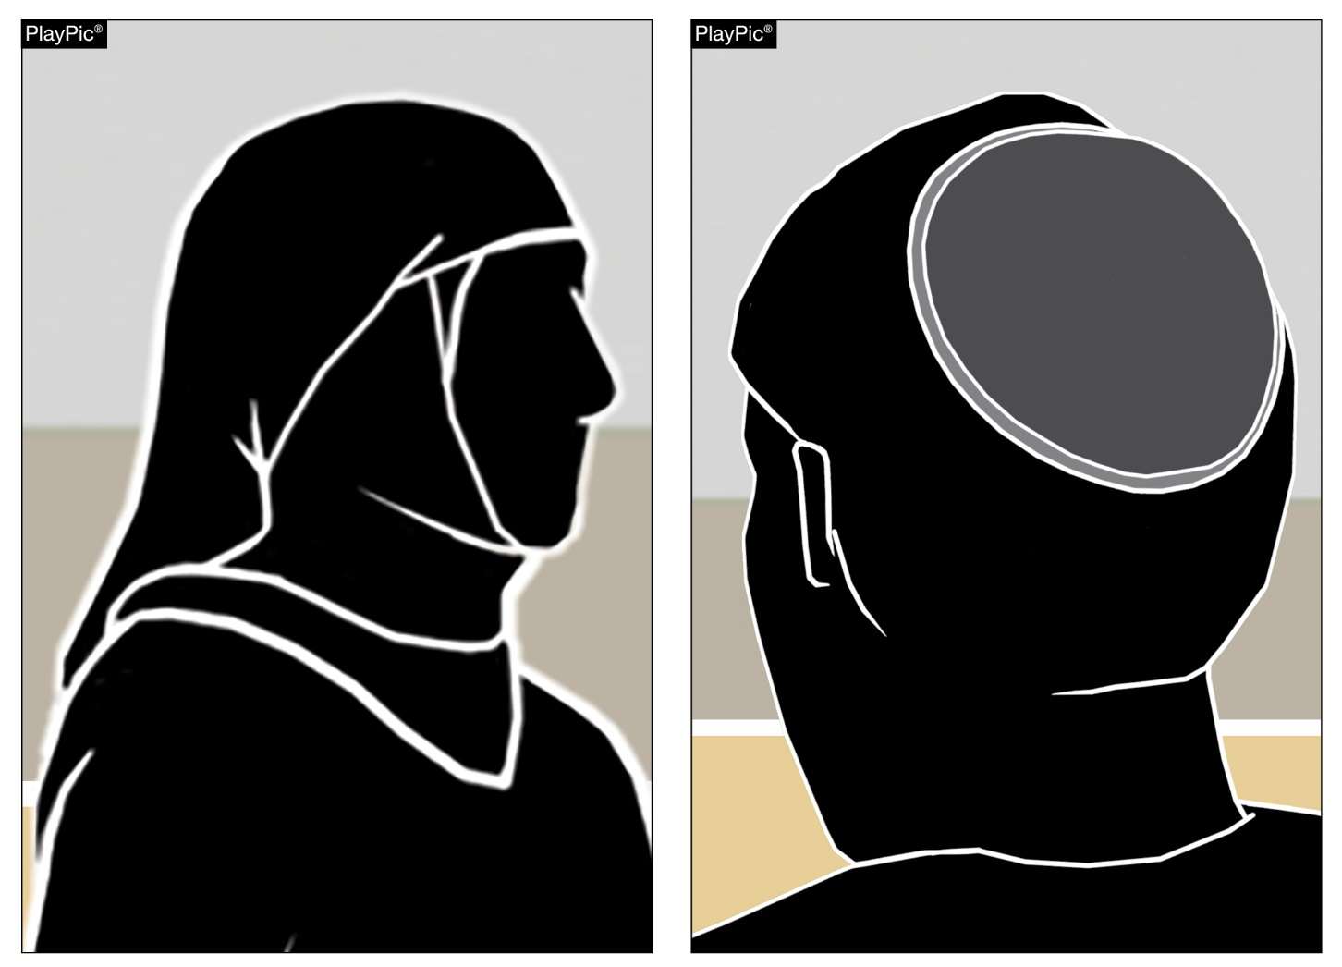
3-5-4e (NEW) RELIGIOUS HEAD COVERINGS
Players may wear head coverings for religious reasons.
Notes:
3-5-4e (NEW) RELIGIOUS HEAD COVERINGS
Players may wear head coverings for religious reasons.

Slide 13
3-5-4F EXCEPTION HEAD COVERING FOR MEDICAL OR COSMETIC REASONS
Head decorations and headwear, except those specified above, are prohibited.
EXCEPTION: State associations may on an individual basis permit a player to participate while wearing a head covering if it meets the following criteria: For medical or cosmetic reasons - In the event a participant is required by a licensed medical physician to cover the head with a covering or wrap, the physician’s statement is required before the state association can approve a covering or wrap which is not abrasive, hard or dangerous to any other player and which is attached in such a way that it is highly unlikely to come off during play.
Notes:
3-5-4f EXCEPTION HEAD COVERINGS FOR MEDICAL OR COSMETIC REASONS
Head decorations and headwear, except those specified above, are prohibited.
EXCEPTION: State associations may on an individual basis permit a player to participate while wearing a head covering if it meets the following criteria: For medical or cosmetic reasons - In the event a participant is required by a licensed medical physician to cover the head with a covering or wrap, the physician’s statement is required before the state association can approve a covering or wrap which is not abrasive, hard or dangerous to any other player and which is attached in such a way that it is highly unlikely to come off during play.

Slide 14
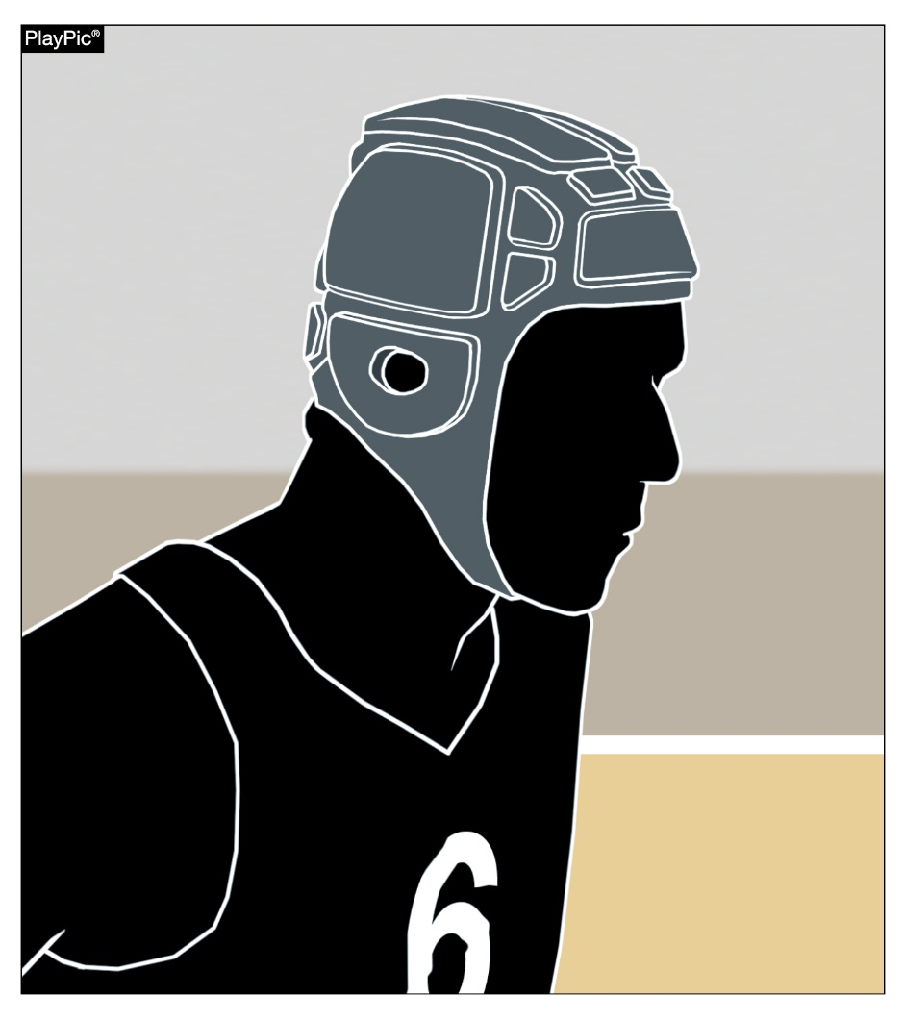
3-5-4f Head coverings worn for medical or cosmetic reasons
A player who needs to wear a head covering for medical or cosmetic reasons is still required to have a letter of permission from the state association.
Notes:
3-5-4f HEAD COVERINGS WORN FOR MEDICAL OR COSMETIC REASONS
A player who needs to wear a head covering for medical or cosmetic reasons is still required to have a letter of permission from the state association.

Slide 15
The MANUAL- Part 3 - SIGNALS 36 & 37
Eliminate signal #37 (Team Control Foul)
Maintain use of signal #36 for Player Control and Team Control Foul
Preceded by stop clock (Signal 4). The same hand used to stop the clock is placed at the back of the head (Signal 36). The directional signal (Signal 6) shall be given and then indicate the ensuing throw in spot (Signal 7).
A common foul committed by a player while that player is in control of the ball or by an airborne shooter.
A common foul committed by a member of the team that has control.
Notes:
The MANUAL- Part 3 - SIGNALS 36 & 37
Eliminate signal #37 (Team Control Foul)
Maintain use of signal #36 for Player Control and Team Control Foul
Preceded by stop clock (Signal 4). The same hand used to stop the clock is placed at the back of the head (Signal 36). The directional signal (Signal 6) shall be given and then indicate the ensuing throw in spot (Signal 7).
A common foul committed by a player while that player is in control of the ball or by an airborne shooter.
A common foul committed by a member of the team that has control.

Slide 16
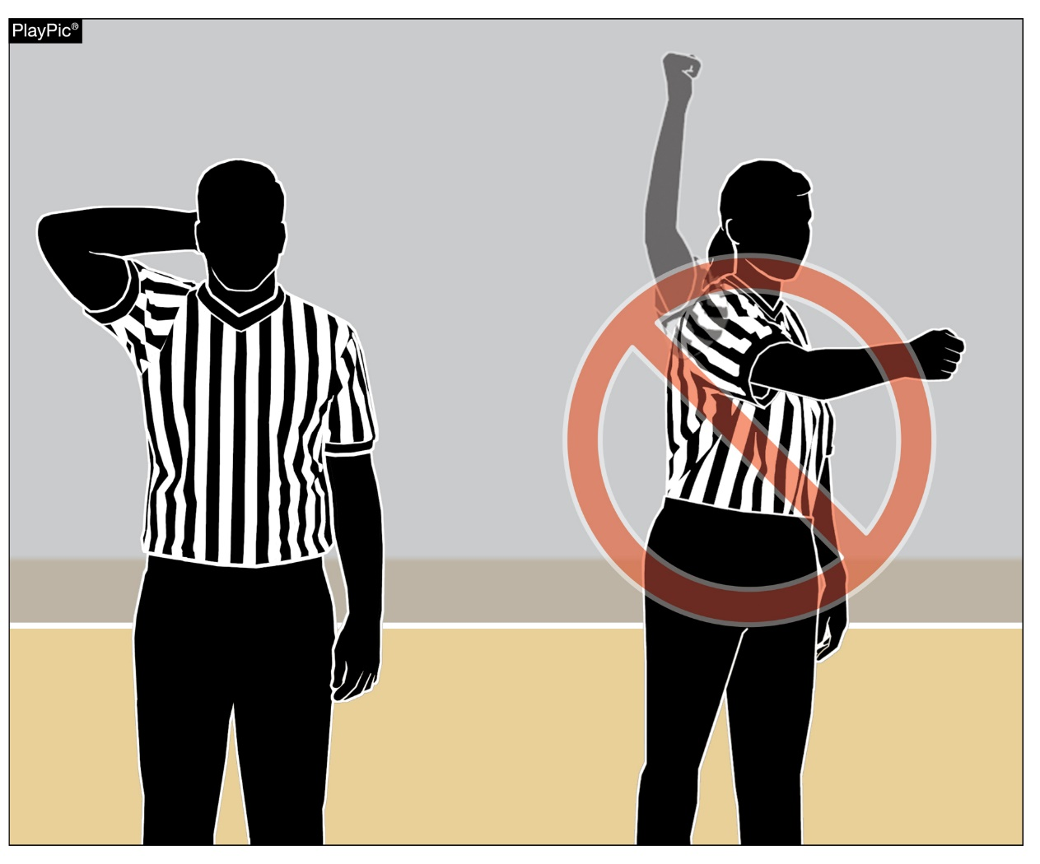
ELIMINATION OF TEAM CONTROL SIGNAL
The player-control foul signal (hand behind the head) will be used to indicate a player-control foul as well as a team-control foul. The punch signal used in the past to indicate a team-control foul was confusing and often used inappropriately.
Notes:
ELIMINATION OF TEAM CONTROL SIGNAL
The player-control foul signal (hand behind the head) will be used to indicate a player-control foul as well as a team-control foul. The punch signal used in the past to indicate a team-control foul was confusing and often used inappropriately.

Slide 17
2021-2022 Points of Emphasis
Notes:
NATIONAL FEDERATION OF STATE HIGH SCHOOL ASSOCIATIONS

Slide 18
OFFICIATING MECHANICS AND SIGNALS
The NFHS Rules Committee expects officials to adhere to the approved mechanics and signals. By using only approved mechanics and signals it adds to the professional image of the officials and shows greater respect for the game. Officials at the High School level are part of an education-based activity and the use of proper mechanics and the avoidance of “personal style” is essential.
The reason for having signals is to communicate to players, coaches, table personnel, fans, and other officials on the floor. The use of approved signals leads to more clear communication between all those involved. To that end, for each ruling the proper sequence of signals is:
Notes:
OFFICIATING MECHANICS AND SIGNALS
The NFHS Rules Committee expects officials to adhere to the approved mechanics and signals. By using only approved mechanics and signals it adds to the professional image of the officials and shows greater respect for the game. Officials at the High School level are part of an education-based activity and the use of proper mechanics and the avoidance of “personal style” is essential.
The reason for having signals is to communicate to players, coaches, table personnel, fans, and other officials on the floor. The use of approved signals leads to more clear communication between all those involved. To that end, for each ruling the proper sequence of signals is:

Slide 19
OFFICIATING MECHANICS AND SIGNALS (cont.)
- Stop the clock using the proper signal for a violation or foul.
- Signal held ball or the type of foul or violation.
- Verbally state the jersey color of the team entitled to the ball for the ensuing throw-in and point in the direction of that team’s basket.
- Indicate the throw-in location.
Note: Due to the change in the approved signal used for player/team control foul, the “punch signal” has been eliminated.
Notes:
OFFICIATING MECHANICS AND SIGNALS (cont.)
- Stop the clock using the proper signal for a violation or foul.
- Signal held ball or the type of foul or violation.
- Verbally state the jersey color of the team entitled to the ball for the ensuing throw-in and point in the direction of that team’s basket.
- Indicate the throw-in location.
Note: Due to the change in the approved signal used for player/team control foul, the “punch signal” has been eliminated.

Slide 20
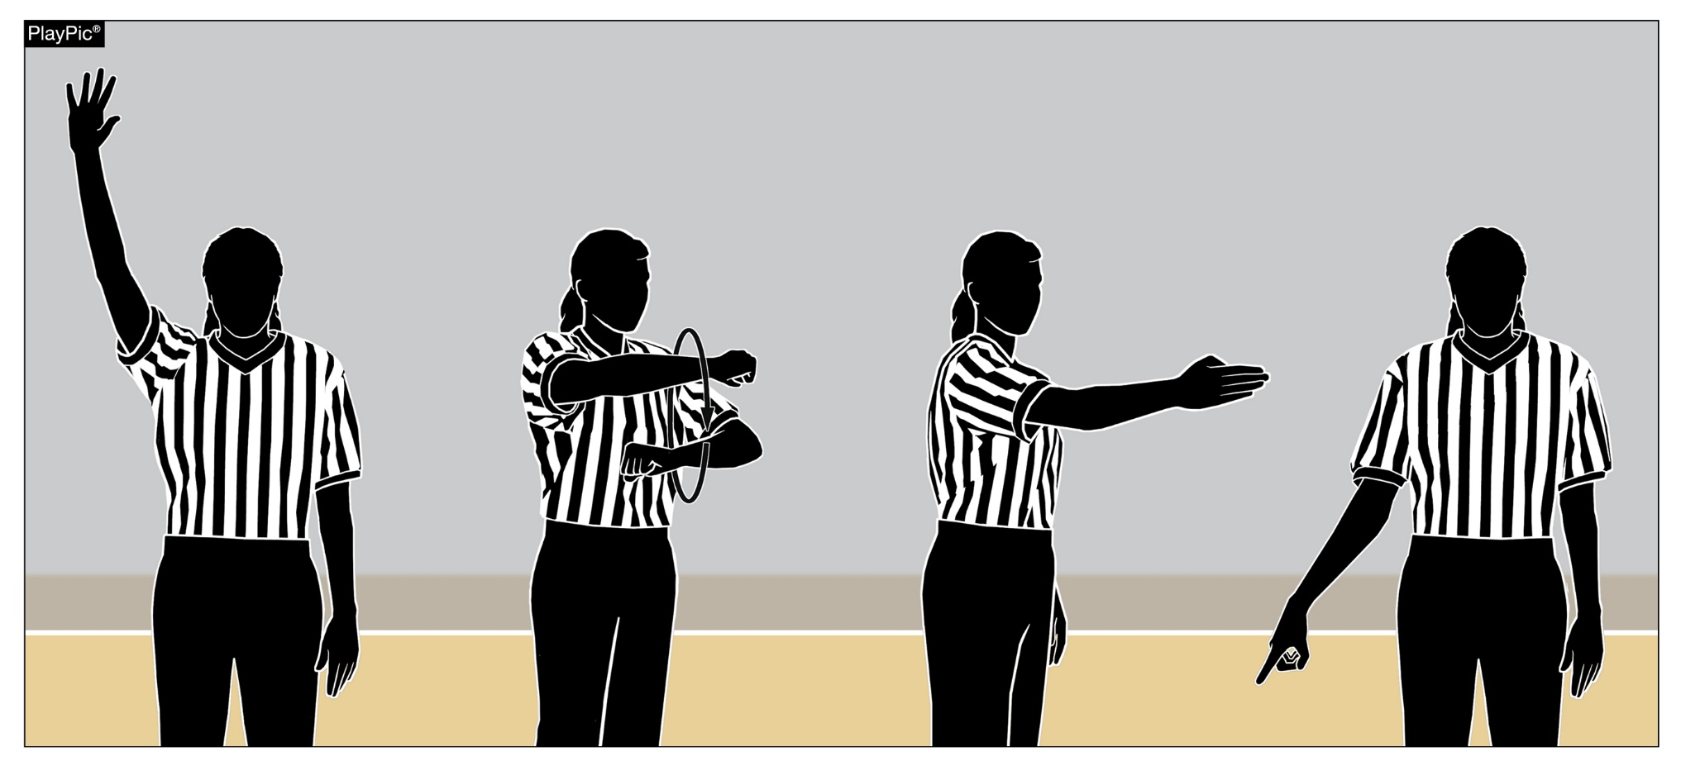
OFFICIATING MECHANICS AND SIGNALS
Signals are used to communicate to players, coaches, table personnel, fans and other officials on the floor what has occurred.
Notes:
OFFICIATING MECHANICS AND SIGNALS
Signals are used to communicate to players, coaches, table personnel, fans and other officials on the floor what has occurred.

Slide 21
TIME-OUT ADMINISTRATION
During a “dead” ball, EITHER team may be granted a time out. During a live ball, only the team in control of the ball may be granted a timeout. It is important officials verify there is PLAYER control prior to granting the request.
- Head Coach requesting: Coaches must understand that just because they have requested a timeout does not guarantee it will be granted. Remember, only the head coach or a player of the team in control of the ball may legally request a timeout. Officials must be sure the head coach is making the request. This request may be oral or visual.
Notes:
TIME-OUT ADMINISTRATION
During a “dead” ball, EITHER team may be granted a time out. During a live ball, only the team in control of the ball may be granted a timeout. It is important officials verify there is PLAYER control prior to granting the request.
- Head Coach requesting: Coaches must understand that just because they have requested a timeout does not guarantee it will be granted. Remember, only the head coach or a player of the team in control of the ball may legally request a timeout. Officials must be sure the head coach is making the request. This request may be oral or visual.

Slide 22
TIME-OUT ADMINISTRATION (cont.)
Player control. The committee is still concerned that officials are granting timeouts while the ball is loose and not in player control. Over the years, an officiating philosophy has developed that teaches officials to grant loose ball timeouts quickly to avoid rough play and stop additional players from diving onto the loose ball pile. While preventing rough play is desirable, that concept cannot supersede the basic rule that a player must be in control of the ball for a timeout to be legally granted. When in doubt, do not grant the timeout. Additionally, do not hesitate to charge fouls for players “jumping on” another player. “Going for the ball” does not justify this rough play.
- Granting Timeout Requests: Ideally, granting the timeout should be the responsibility of the primary coverage official. However, other official(s) may become aware that a timeout is being requested. In all cases, officials must be certain there is player control prior to granting the timeout request. Officials should also be aware of situations where timeouts are more likely to be requested e.g. end of the period/ game or a team has made several baskets in a row.
Notes:
TIME-OUT ADMINISTRATION (cont.)
Player control. The committee is still concerned that officials are granting timeouts while the ball is loose and not in player control. Over the years, an officiating philosophy has developed that teaches officials to grant loose ball timeouts quickly to avoid rough play and stop additional players from diving onto the loose ball pile. While preventing rough play is desirable, that concept cannot supersede the basic rule that a player must be in control of the ball for a timeout to be legally granted. When in doubt, do not grant the timeout. Additionally, do not hesitate to charge fouls for players “jumping on” another player. “Going for the ball” does not justify this rough play.
-Granting Timeout Requests: Ideally, granting the timeout should be the responsibility of the primary coverage official. However, other official(s) may become aware that a timeout is being requested. In all cases, officials must be certain there is player control prior to granting the timeout request. Officials should also be aware of situations where timeouts are more likely to be requested e.g. end of the period/ game or a team has made several baskets in a row.

Slide 23
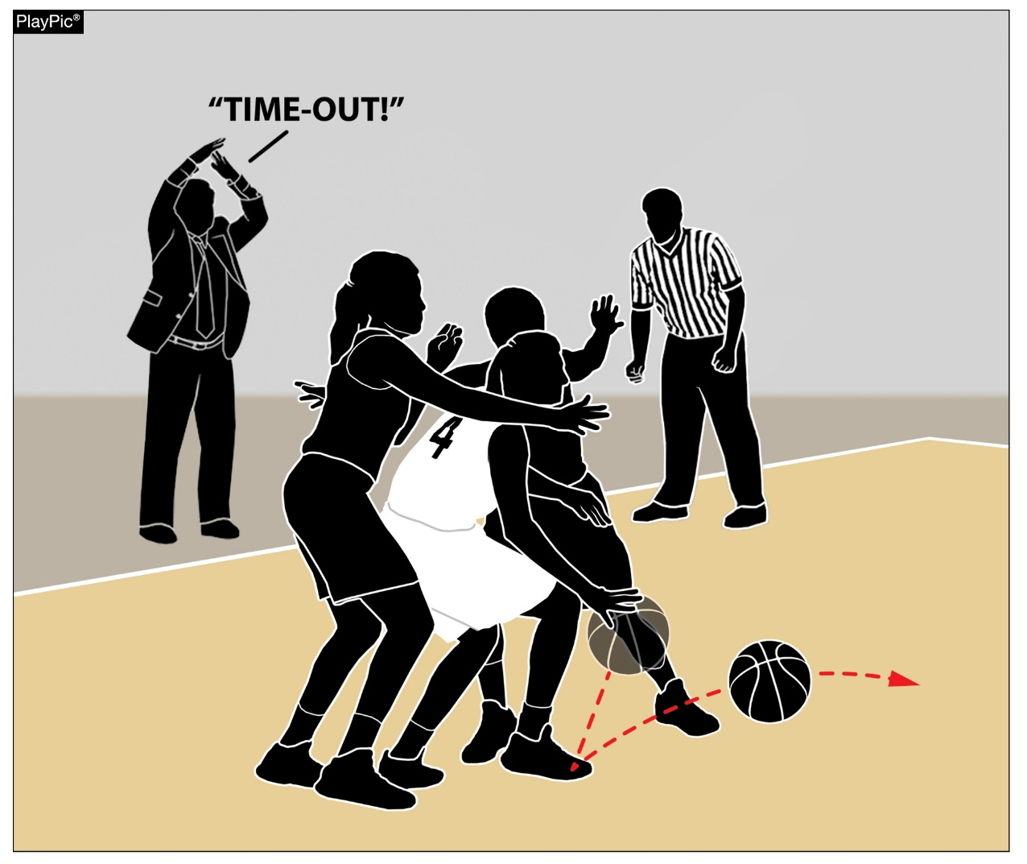
TIMEOUT ADMINISTRATION
A player must be in possession of the ball for the coach of that team or a player of that team to call a timeout.
Notes:
TIMEOUT ADMINISTRATION
A player must be in possession of the ball for the coach of that team or a player of that team to call a timeout.

Slide 24
UNSPORTING CONDUCT
Unsporting conduct. The committee is concerned about inappropriate conduct by players, bench personnel, coaches, officials, and spectators. Programs are educationally based and conduct that is not tolerated in other educational settings shall not be accepted. Therefore, each group has the responsibility to demonstrate civility and citizenship.
To this effect:
Game management needs to pay particular attention to spectators. Game Management should intervene when spectator behavior becomes unacceptable. This should be done prior to an official having to make such a request.
When game management fails to address spectator behavior on their own, officials should remind game management to hold spectators accountable for their actions. A game ticket is not a license to abuse.
Notes:
UNSPORTING CONDUCT
Unsporting conduct. The committee is concerned about inappropriate conduct by players, bench personnel, coaches, officials, and spectators. Programs are educationally based and conduct that is not tolerated in other educational settings shall not be accepted. Therefore, each group has the responsibility to demonstrate civility and citizenship.
To this effect:
Game management needs to pay particular attention to spectators. Game Management should intervene when spectator behavior becomes unacceptable. This should be done prior to an official having to make such a request.
When game management fails to address spectator behavior on their own, officials should remind game management to hold spectators accountable for their actions. A game ticket is not a license to abuse.

Slide 25
UNSPORTING CONDUCT (cont.)
Officials should not tolerate inappropriate conduct from coaches and/or players. The rules allow for a “warning” to be given to coaches and it should be utilized when appropriate.
The team huddle is not a safe haven for coaches’ bad language. Just as a classroom teacher should not verbally abuse students, neither should coaches use bad language when addressing their players.
Players are not permitted to “let off steam” by using profanity, even if it is not directed at an opponent or official. Being angry at oneself is no excuse.
Officials are not exempt from unsporting conduct. Inappropriate references to players, coaches or other officials is not acceptable. Inappropriate behavior before, during or after the game should be reported to the official’s association /assignor.
Notes:
UNSPORTING CONDUCT (cont.)
Officials should not tolerate inappropriate conduct from coaches and/or players. The rules allow for a “warning” to be given to coaches and it should be utilized when appropriate.
The team huddle is not a safe haven for coaches’ bad language. Just as a classroom teacher should not verbally abuse students, neither should coaches use bad language when addressing their players.
Players are not permitted to “let off steam” by using profanity, even if it is not directed at an opponent or official. Being angry at oneself is no excuse.
Officials are not exempt from unsporting conduct. Inappropriate references to players, coaches or other officials is not acceptable. Inappropriate behavior before, during or after the game should be reported to the official’s association /assignor.

Slide 26
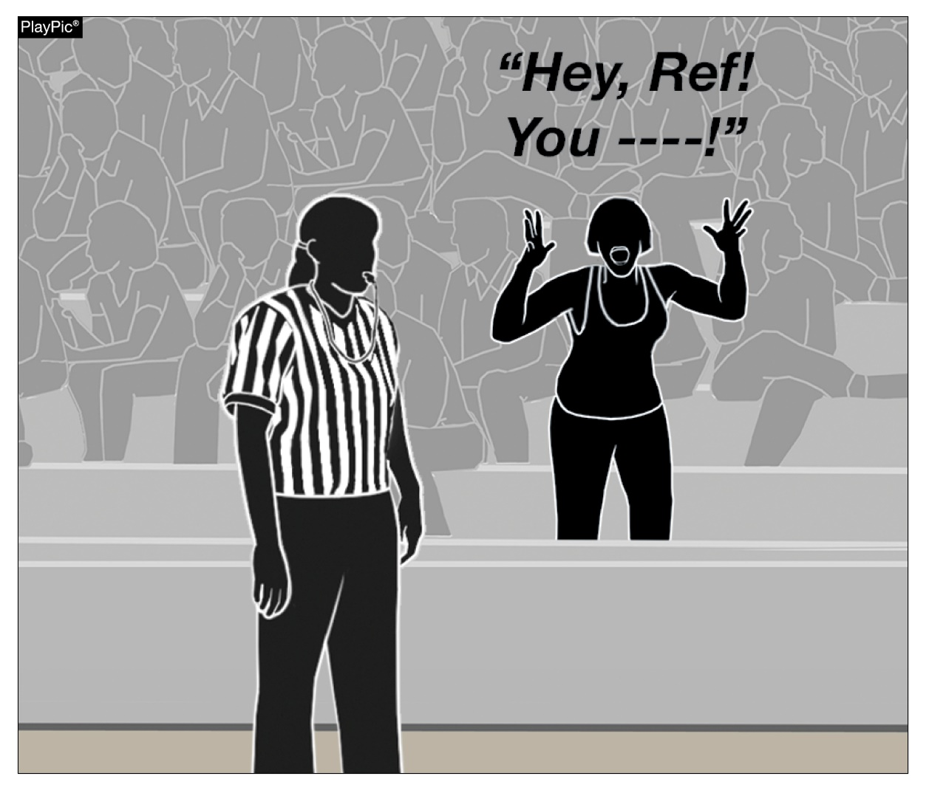
UNSPORTING CONDUCT
Spectators should be held accountable for their inappropriate behavior.
Notes:
UNSPORTING CONDUCT
Spectators should be held accountable for their inappropriate behavior.

Slide 27
SCREENING
Screening is a legal action to delay a player while touching the floor, without causing contact to prevent an opponent from reaching a desired position.
Legal screening is when the player who is screening an opponent:
Is stationary (within the vertical plane) when contact occurs.
Has both feet on the floor when contact occurs.
Time and distance are relevant.
The screener shall be stationary, except when both the screener and opponent are moving in the same path and the same direction.
Notes:
SCREENING
Screening is a legal action to delay a player while touching the floor, without causing contact to prevent an opponent from reaching a desired position.
Legal screening is when the player who is screening an opponent:
Is stationary (within the vertical plane) when contact occurs.
Has both feet on the floor when contact occurs.
Time and distance are relevant.
The screener shall be stationary, except when both the screener and opponent are moving in the same path and the same direction.

Slide 28
SCREENING (cont.)
Illegal screening is when the player who is screening an opponent:
Is moving when contact occurred.
Does not give sufficient distance in setting a screen outside the field of vision of a stationary opponent when contact occurred.
Does not respect the elements of time and distance of an opponent in motion when contact occurred.
A player may not use arms, hands, hips, or shoulders to force movement through a screen or hold the screener and then push the screener aside in order to maintain legal guarding position.
Notes:
SCREENING (cont.)
Illegal screening is when the player who is screening an opponent:
Is moving when contact occurred.
Does not give sufficient distance in setting a screen outside the field of vision of a stationary opponent when contact occurred.
Does not respect the elements of time and distance of an opponent in motion when contact occurred.
A player may not use arms, hands, hips, or shoulders to force movement through a screen or hold the screener and then push the screener aside in order to maintain legal guarding position.

Slide 29
SCREENING (cont.)
If the screen is set within the field of vision of a stationary opponent (front or lateral), the screener may establish the screen as close to the opponent as desired, provided there is no contact.
If the screen is set outside the field of vision of a stationary opponent, the screener must permit the opponent to take 1 normal step towards the screen without making contact.
If the opponent is in motion, the elements of time and distance shall apply. The screener must leave enough space so that the player who is being screened is able to avoid the screen by stopping or changing direction.
Notes:
SCREENING (cont.)
If the screen is set within the field of vision of a stationary opponent (front or lateral), the screener may establish the screen as close to the opponent as desired, provided there is no contact.
If the screen is set outside the field of vision of a stationary opponent, the screener must permit the opponent to take 1 normal step towards the screen without making contact.
If the opponent is in motion, the elements of time and distance shall apply. The screener must leave enough space so that the player who is being screened is able to avoid the screen by stopping or changing direction.
The distance required is never less than 1 and never more than 2 normal steps.
A player who is legally screened is responsible for any contact with the player who has set the screen.

Slide 30
SCREENING (cont.)
The distance required is never less than 1 and never more than 2 normal steps.
A player who is legally screened is responsible for any contact with the player who has set the screen.
Notes:
SCREENING (cont.)
The distance required is never less than 1 and never more than 2 normal steps.
A player who is legally screened is responsible for any contact with the player who has set the screen.

Slide 31
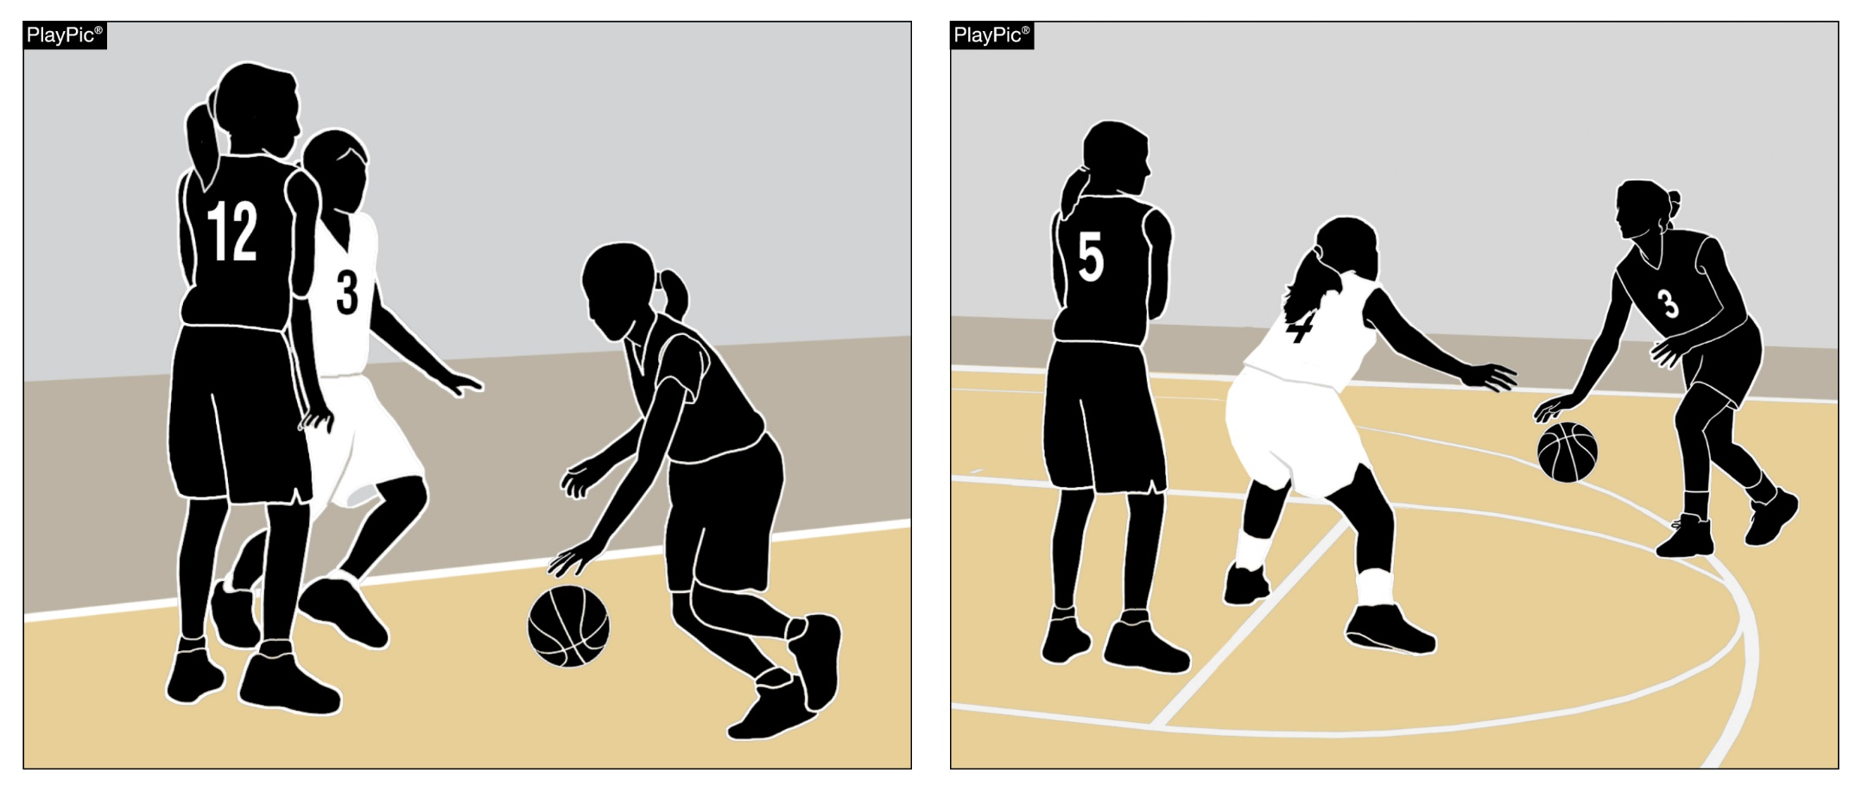
SCREENING
Screening is a legal action to delay a player while touching the playing court, without causing contact delays or to prevent an opponent from reaching a desired position.
Notes:
SCREENING
Screening is a legal action to delay a player while touching the playing court, without causing contact delays or to prevent an opponent from reaching a desired position.

Slide 32
EURO-STEPS, SPIN MOVES, AND JUMP STOPS – LEGAL OR ILLEGAL?
If executed within the parameters of the 4.44 traveling rule, each of these plays is legal. If not executed within the rules, each of these plays is illegal. High school players often attempt to emulate players they watch at higher levels but because collegiate and professional rules, interpretations, and directives vary, what is legal at one level may not be legal at another.
Notes:
EURO-STEPS, SPIN MOVES, AND JUMP STOPS – LEGAL OR ILLEGAL?
If executed within the parameters of the 4.44 traveling rule, each of these plays is legal. If not executed within the rules, each of these plays is illegal. High school players often attempt to emulate players they watch at higher levels but because collegiate and professional rules, interpretations, and directives vary, what is legal at one level may not be legal at another.

Slide 33
EURO-STEPS, SPIN MOVES, AND JUMP STOPS – LEGAL OR ILLEGAL?
What is referred to as a Euro Step most often occurs when a player who is dribbling toward the basket stops dribbling, catches the ball while both feet are off the floor, lands on one foot and steps laterally with the other foot, often to step around a defender, all while facing the basket. The first foot to land on the floor is the pivot foot and if the player releases the ball on a try for goal or pass before the pivot foot touches the floor again, it is legal. If the player’s pivot foot touches the floor a second time before the player releases the ball, it is illegal.
Notes:
EURO-STEPS, SPIN MOVES, AND JUMP STOPS – LEGAL OR ILLEGAL?
What is referred to as a Euro Step most often occurs when a player who is dribbling toward the basket stops dribbling, catches the ball while both feet are off the floor, lands on one foot and steps laterally with the other foot, often to step around a defender, all while facing the basket. The first foot to land on the floor is the pivot foot and if the player releases the ball on a try for goal or pass before the pivot foot touches the floor again, it is legal. If the player’s pivot foot touches the floor a second time before the player releases the ball, it is illegal.

Slide 34
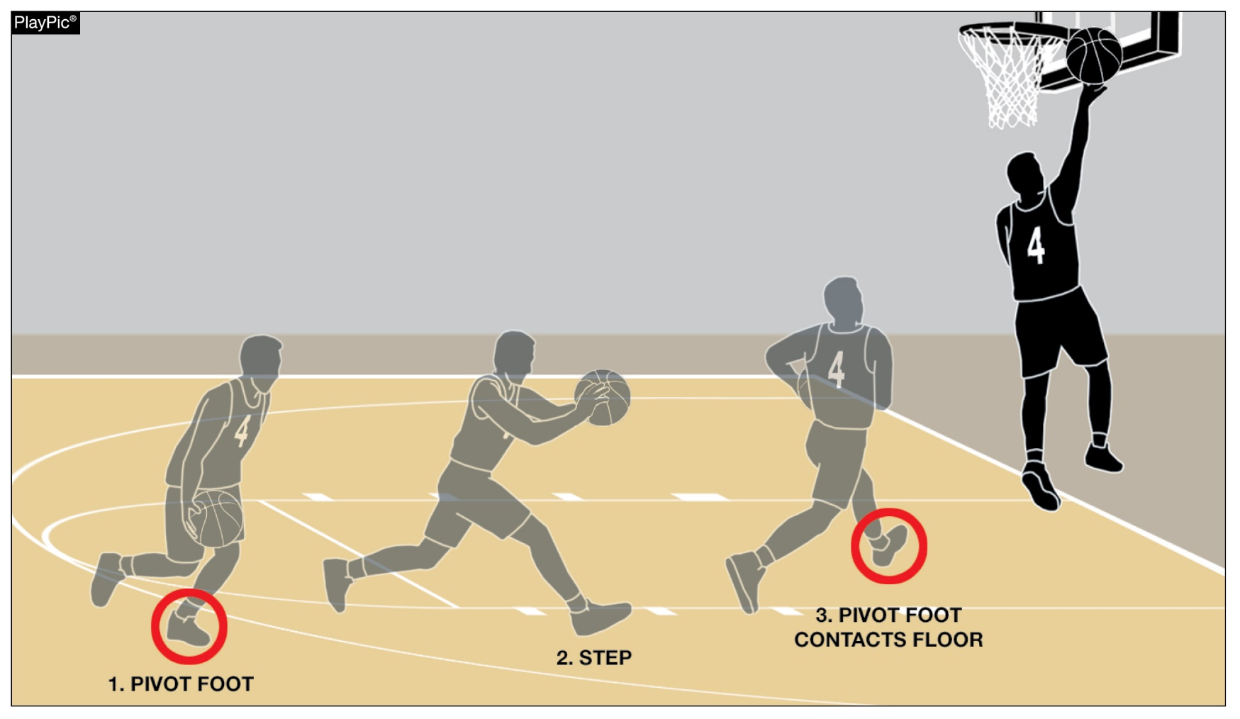
EURO-STEPS, SPIN MOVES AND JUMP STOPS: LEGAL OR ILLEGAL?
On the Euro-Step, if the pivot foot touches the floor before the shot is taken, it is a travel.
Notes:
EURO-STEPS, SPIN MOVES AND JUMP STOPS: LEGAL OR ILLEGAL?
On the Euro-Step, if the pivot foot touches the floor before the shot is taken, it is a travel.

Slide 35
EURO-STEPS, SPIN MOVES, AND JUMP STOPS – LEGAL OR ILLEGAL? (cont.)
What is often referred to as a Spin Move most often occurs when a player who dribbles toward the basket, catches the ball while faking to one side of the basket, plants a foot (becomes the pivot foot), while facing the basket, turns his or her back to the basket in an attempt to “spin” around a defender, then steps with the other foot. This would be legal but most often when the player’s back is to the basket during the spin, to again face the basket and get into position to release the ball on a try, the player must step again. This means the player’s pivot foot returns to the floor a second time, thus causing a traveling violation.
Notes:
EURO-STEPS, SPIN MOVES, AND JUMP STOPS – LEGAL OR ILLEGAL? (cont.)
What is often referred to as a Spin Move most often occurs when a player who dribbles toward the basket, catches the ball while faking to one side of the basket, plants a foot (becomes the pivot foot), while facing the basket, turns his or her back to the basket in an attempt to “spin” around a defender, then steps with the other foot. This would be legal but most often when the player’s back is to the basket during the spin, to again face the basket and get into position to release the ball on a try, the player must step again. This means the player’s pivot foot returns to the floor a second time, thus causing a traveling violation.

Slide 36
EURO-STEPS, SPIN MOVES, AND JUMP STOPS – LEGAL OR ILLEGAL? (cont.)
Example: A1 is dribbling toward the basket from the left side. Defender B1 is facing A1 when A1 catches the ball and steps with the left foot while faking to the left, then spins (back to the basket), steps with the right foot while spinning and then steps with the left foot again. When beginning the spin move, A1’s left foot became the pivot foot and after the spin, when the left foot again touches the floor, A1 has violated. This type of play could originate from in front of the basket or from either side. Due to the speed of the player attempting a spin move and the physical difficulty of facing the basket when one foot touches the floor, then attempting to spin around a defender and release the ball before the pivot foot again touches the floor, the vast majority of spin move attempts are illegal.
Notes:
EURO-STEPS, SPIN MOVES, AND JUMP STOPS – LEGAL OR ILLEGAL? (cont.)
Example: A1 is dribbling toward the basket from the left side. Defender B1 is facing A1 when A1 catches the ball and steps with the left foot while faking to the left, then spins (back to the basket), steps with the right foot while spinning and then steps with the left foot again. When beginning the spin move, A1’s left foot became the pivot foot and after the spin, when the left foot again touches the floor, A1 has violated. This type of play could originate from in front of the basket or from either side. Due to the speed of the player attempting a spin move and the physical difficulty of facing the basket when one foot touches the floor, then attempting to spin around a defender and release the ball before the pivot foot again touches the floor, the vast majority of spin move attempts are illegal.

Slide 37
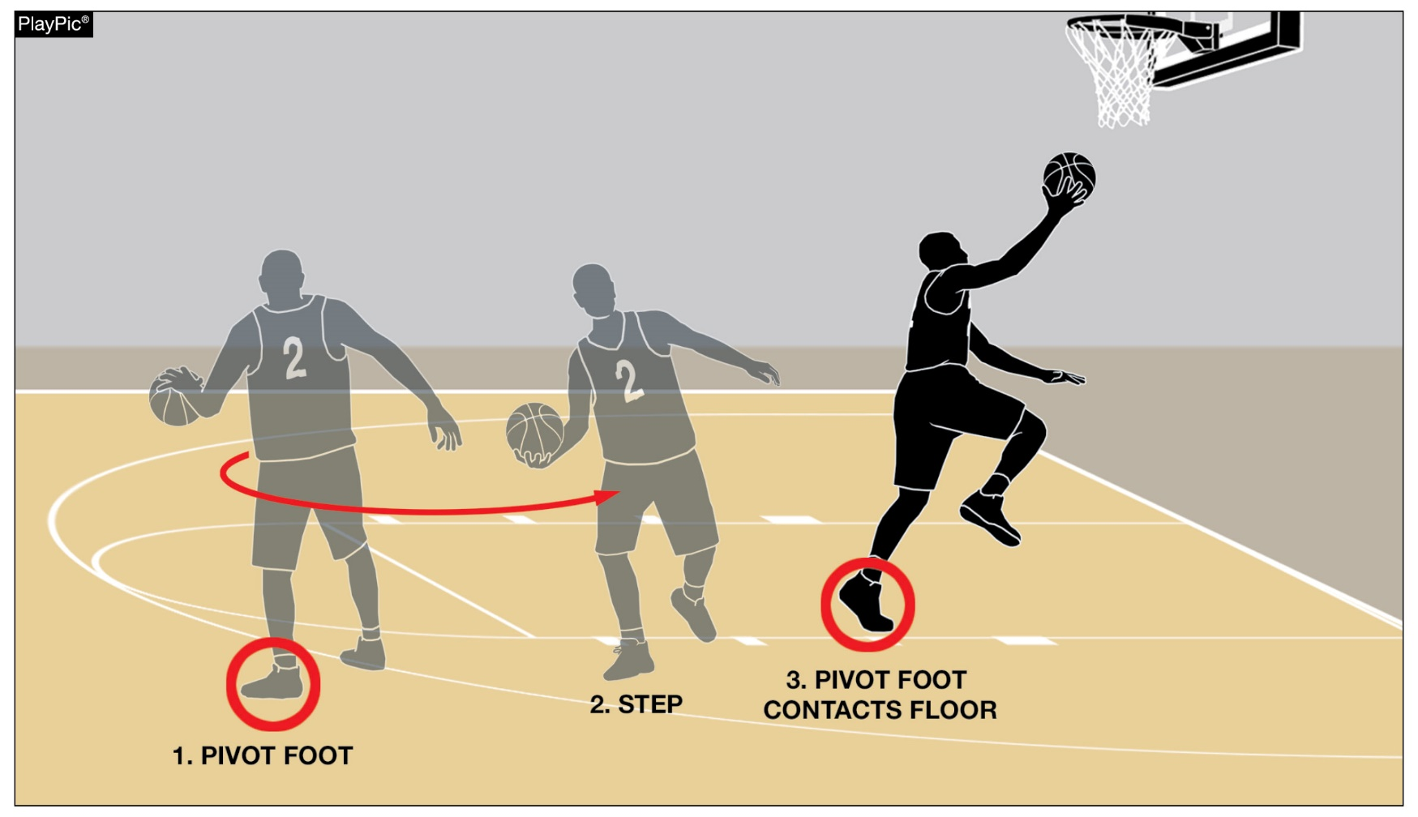
EURO-STEPS, SPIN MOVES AND JUMP STOPS: LEGAL OR ILLEGAL?
On the Spin Move, if a player picks up the pivot foot and touches it to the floor again before the release of the ball on a try for goal, that player has traveled.
Notes:
EURO-STEPS, SPIN MOVES AND JUMP STOPS: LEGAL OR ILLEGAL?
On the Spin Move, if a player picks up the pivot foot and touches it to the floor again before the release of the ball on a try for goal, that player has traveled.

Slide 38
EURO-STEPS, SPIN MOVES, AND JUMP STOPS – LEGAL OR ILLEGAL? (cont.)
What is often referred to as a Jump Stop is, by rule, an exception to the traveling rules. A legal jump stop occurs when a player who catches the ball with both feet off the floor, lands on one foot, jumps off that foot and lands with both feet touching the floor simultaneously. Many players are taught well and successfully execute legal jump stops. There are two situations that most often cause attempts at legal jump stops to become illegal. The first: After the player jumps off one foot, the player lands on one foot followed by the other (illegal “stutter step”), instead of landing simultaneously on both feet (legal).
Notes:
EURO-STEPS, SPIN MOVES, AND JUMP STOPS – LEGAL OR ILLEGAL? (cont.)
What is often referred to as a Jump Stop is, by rule, an exception to the traveling rules. A legal jump stop occurs when a player who catches the ball with both feet off the floor, lands on one foot, jumps off that foot and lands with both feet touching the floor simultaneously. Many players are taught well and successfully execute legal jump stops. There are two situations that most often cause attempts at legal jump stops to become illegal. The first: After the player jumps off one foot, the player lands on one foot followed by the other (illegal “stutter step”), instead of landing simultaneously on both feet (legal).

Slide 39
EURO-STEPS, SPIN MOVES, AND JUMP STOPS – LEGAL OR ILLEGAL? (cont.)
The second: After the player completes a legal jump stop, the player pivots. A legal jump stop is already an exception to the travel rule and a player who pivots with either foot after a jump stop is completed gains a huge advantage and has committed a traveling violation.
Landing on both feet, under NFHS rules the player violates when the pivot foot touches the floor the second time.
We encourage players, coaches, and officials to study and learn the rules governing these exciting basketball plays as they relate to NFHS rules.
Notes:
EURO-STEPS, SPIN MOVES, AND JUMP STOPS – LEGAL OR ILLEGAL? (cont.)
The second: After the player completes a legal jump stop, the player pivots. A legal jump stop is already an exception to the travel rule and a player who pivots with either foot after a jump stop is completed gains a huge advantage and has committed a traveling violation.
Landing on both feet, under NFHS rules the player violates when his or her pivot foot touches the floor the second time.
We encourage players, coaches, and officials to study and learn the rules governing these exciting basketball plays as they relate to NFHS rules.

Slide 40
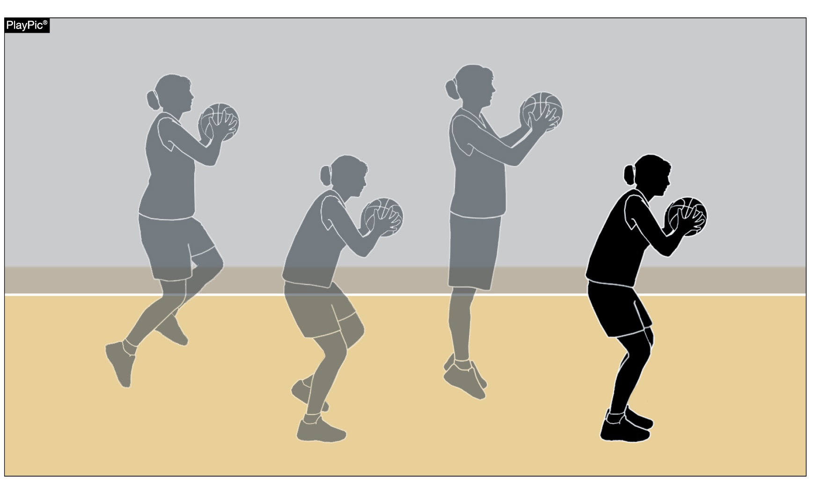
EURO-STEPS, SPIN MOVES AND JUMP STOPS: LEGAL OR ILLEGAL?
A player who performs a legal Jump Stop does not have a pivot foot. If a pivot is used, that player has traveled.
Notes:
EURO-STEPS, SPIN MOVES AND JUMP STOPS: LEGAL OR ILLEGAL?
A player who performs a legal Jump Stop does not have a pivot foot. If a pivot is used, that player has traveled.

Slide 41
TRAVELING - BASIC FUNDAMENTALS
When beginning a dribble, a player must release the ball before lifting his or her pivot foot. A player who lifts the pivot foot before releasing the ball to begin a dribble has committed a traveling violation.
It is always legal for a player to lift the pivot foot, but the player must pass, shoot, or be granted a time-out before the pivot foot touches the floor again.
It is not possible for a player to travel while dribbling the ball, bouncing the ball while out-of- bounds during a throw-in or prior to attempting free throw(s).
Notes:
TRAVELING - BASIC FUNDAMENTALS
When beginning a dribble, a player must release the ball before lifting his or her pivot foot. A player who lifts the pivot foot before releasing the ball to begin a dribble has committed a traveling violation.
It is always legal for a player to lift the pivot foot but the player must pass, shoot, or be granted a time-out before the pivot foot touches the floor again.
It is not possible for a player to travel while dribbling the ball, bouncing the ball while out-of-bounds during a throw-in or prior to attempting free throw(s).

Slide 42
TRAVELING - BASIC FUNDAMENTALS (cont.)
For officials, identifying a player’s pivot foot is, by far, the most important aspect of accurately ruling potential traveling violations. Videos, traveling presentations, and practice are effective tools available to officials who want to improve their accuracy of ruling potential traveling plays.
Traveling rules are relatively easy to learn and understand but because of the sheer number of potential traveling violations that occur in every game and the speed at which many of these plays occur, making a high percentage of accurate rulings is difficult. In some instances, officials appear to rule on these plays based on what it “looks like,” rather than what rules allow. To improve the teaching, execution, and accurate rulings of potential traveling situations, players, coaches, and officials should review relevant rule descriptions and take advantage of available information … and practice!
Notes:
TRAVELING - BASIC FUNDAMENTALS (cont.)
For officials, identifying a player’s pivot foot is, by far, the most important aspect of accurately ruling potential traveling violations. Videos, traveling presentations, and practice are effective tools available to officials who want to improve their accuracy of ruling potential traveling plays.
Traveling rules are relatively easy to learn and understand but because of the sheer number of potential traveling violations that occur in every game and the speed at which many of these plays occur, making a high percentage of accurate rulings is difficult. In some instances, officials appear to rule on these plays based on what it “looks like,” rather than what rules allow. To improve the teaching, execution, and accurate rulings of potential traveling situations, players, coaches, and officials should review relevant rule descriptions and take advantage of available information … and practice!

Slide 43
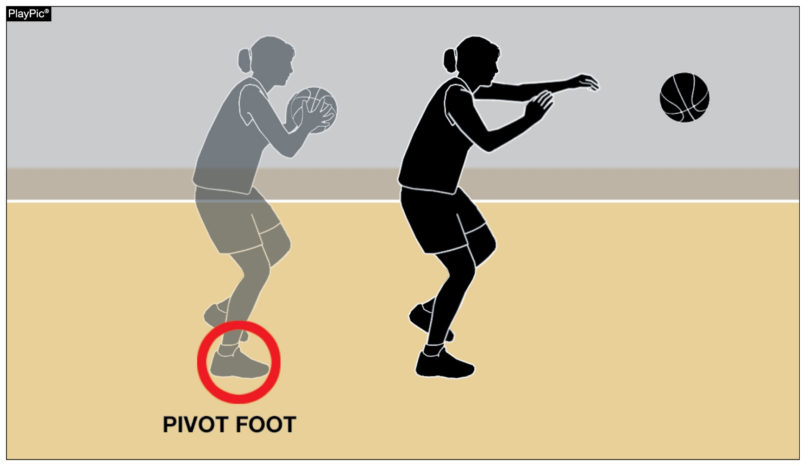
TRAVELING: BASIC FUNDAMENTALS
Identifying a player’s pivot foot is key to accurately ruling on potential traveling violations.
Notes:
TRAVELING: BASIC FUNDAMENTALS
Identifying a player’s pivot foot is key to accurately ruling on potential traveling violations.

Slide 44
Concussion Management
Notes:
NATIONAL FEDERATION OF STATE HIGH SCHOOL ASSOCIATIONS

Slide 45

olicyCCT
Concussion Management
Official’s Role
Observe and be more cognizant of athletes displaying signs, symptoms & behaviors consistent with a concussion.
Advise coach that - “the player should be checked out”, similar to injury or bleeding rule.
Do Not say - “the athlete has a concussion”.

Slide 46
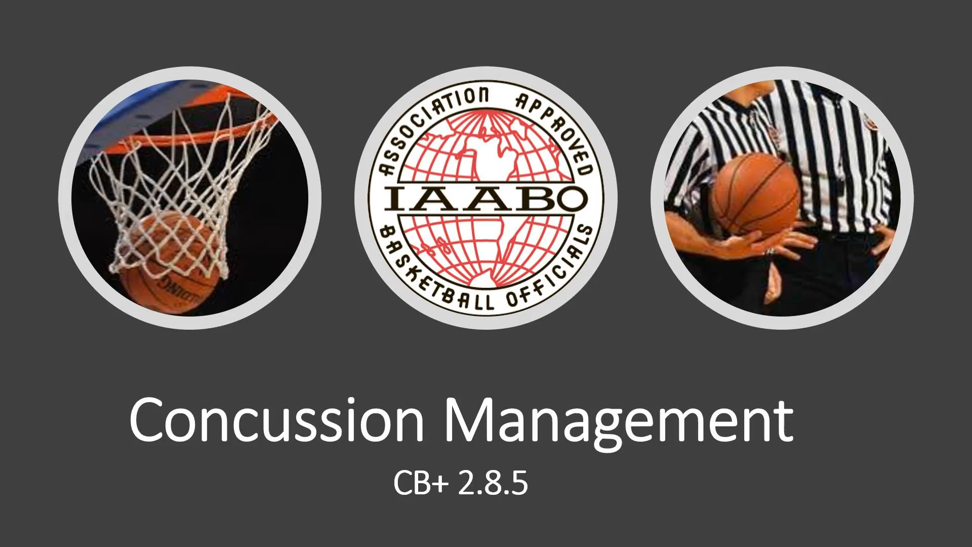
Concussion Management Video

Slide 47
Apparell Reminders
Notes:
NATIONAL FEDERATION OF STATE HIGH SCHOOL ASSOCIATIONS

Slide 48
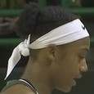
APPAREL REMINDERS
The cloth headband that is tied in the back is ILLEGAL.
The fact that the extensions are tucked in DOES NOT make it legal.
The inconsistencies in enforcement across boards and across our membership caused many problems in previous years.
Let’s PLEASE be more vigilant in enforcing this rule consistently across the state
ILLEGAL APPAREL
Headbands may not be knotted or have extensions, even if the extensions are tucked in.

Slide 49
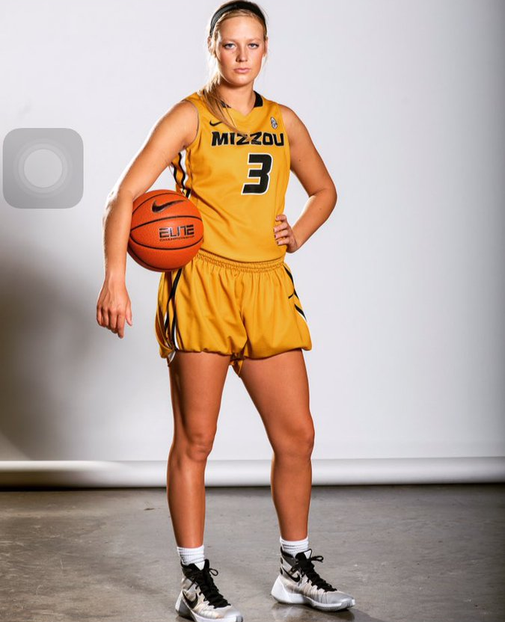
APPAREL REMINDERS
Tucking the bottom of the shorts under the bottom of the compression shorts is ILLEGAL.

Slide 50
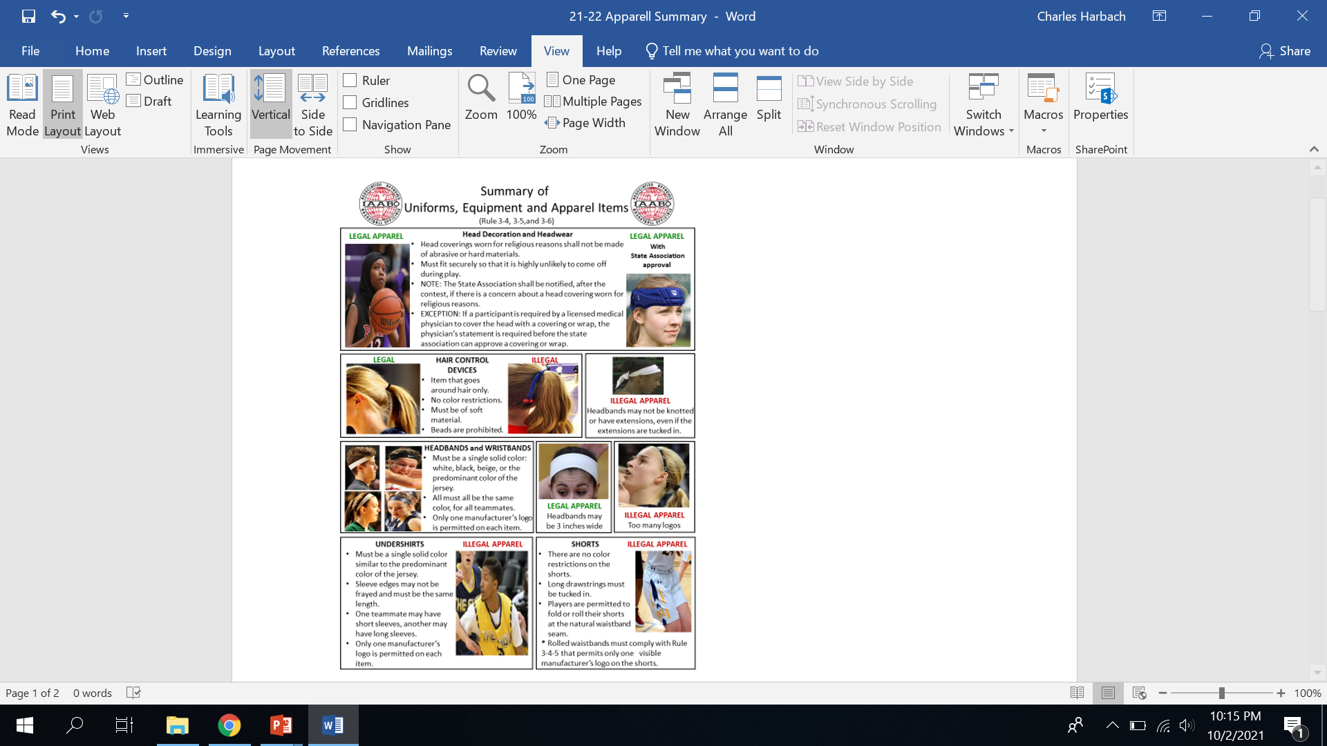
APPAREL REMINDERS

Slide 51
APPAREL REMINDERS

Slide 52
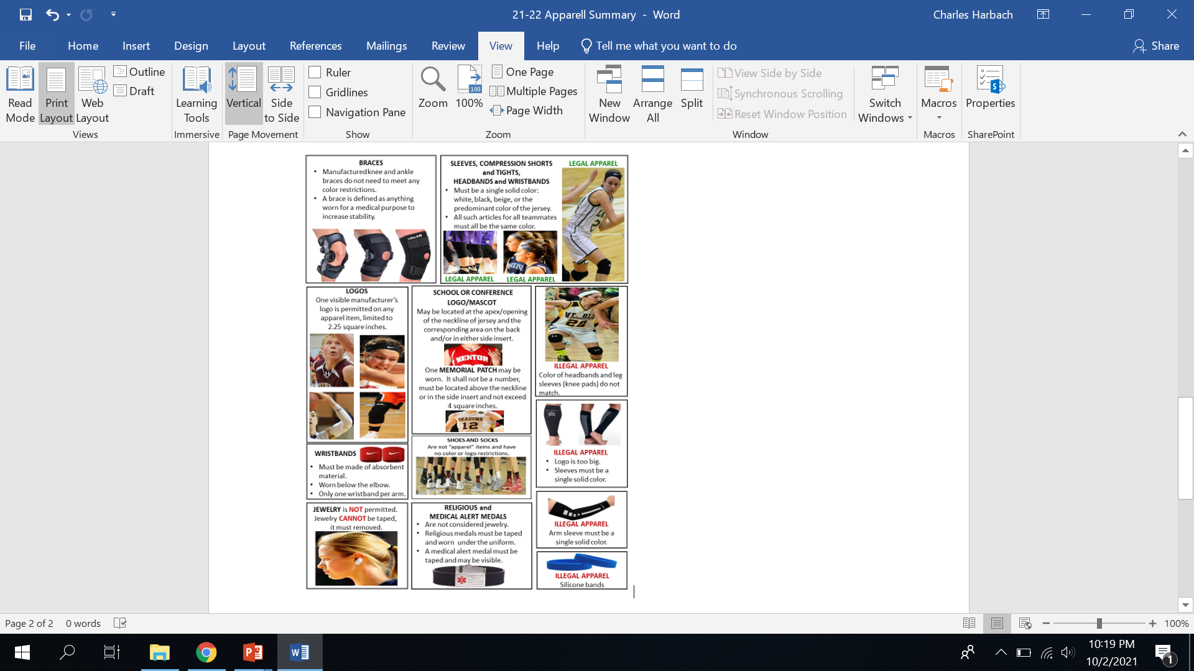
APPAREL REMINDERS

Slide 53
APPAREL REMINDERS

Slide 54
APPAREL REMINDERS

Slide 55
CT adopted Mechanics
Notes:
NATIONAL FEDERATION OF STATE HIGH SCHOOL ASSOCIATIONS

Slide 56
Olicy CONNECTICUT ADOPTED MECHANICSCCT
Coaching Box must be marked.
CIAC directive - If home coach and/or home management refuse to designate unmarked coaching box with tape, the home team will not be permitted the use of a coaching box for that game.
However, the visiting team will be allowed the use of a coaching box.
Notify your Interpreter or Secretary the next day, who will notify CIAC.

Slide 57
Olicy CONNECTICUT ADOPTED MECHANICSCCT
Point to the floor with “one” finger to indicate foot touching “3” point line (i.e. 2 point field goal is being attempted).
Team members are not allowed to congregate at division line or on school logo during introductions. Coaches and officials will direct players to free throw line area in front of respective benches.

Slide 58
OlicyCONNECTICUT ADOPTED MECHANICSCCT
Captains-Head Coaches-Officials pre-game meeting
should occur from 5 to 10 minutes prior to start of game.
If the head coach refuses to attend the meeting, notify your Interpreter or Secretary, who will notify the school Athletic Director and CIAC.

Slide 59

IAABO
IF IT DOESN’T MATTER, THEN DO IT THE “RIGHT WAY”
“The IAABO Way!”
“ONE RULE, ONE INTERPRETATION
ONE SET OF APPROVED MECHANICS, ONE COMMON LANGUAGE”

Slide 60
What Questions do you have?

Slide 61
CaseBook Error
Page 59, case 7.5.7 Situation B, 2nd sentence: “At the conclusion of the game, Team A …”; Team A should read Team B.
Notes:
2020-21 NFHS basketball Rules Power Point

Slide 62
National federation of state high school associations (NFHS)
Notes:
NATIONAL FEDERATION OF STATE HIGH SCHOOL ASSOCIATIONS

Slide 63
NFHS Basketball rule changes
2021-22
Notes:
2021-22 NFHS BASKETBALL RULE CHANGES

Slide 64
NFHS OFFICIALS Education
Notes:
NFHS OFFICIALS EDUCATION

Slide 65
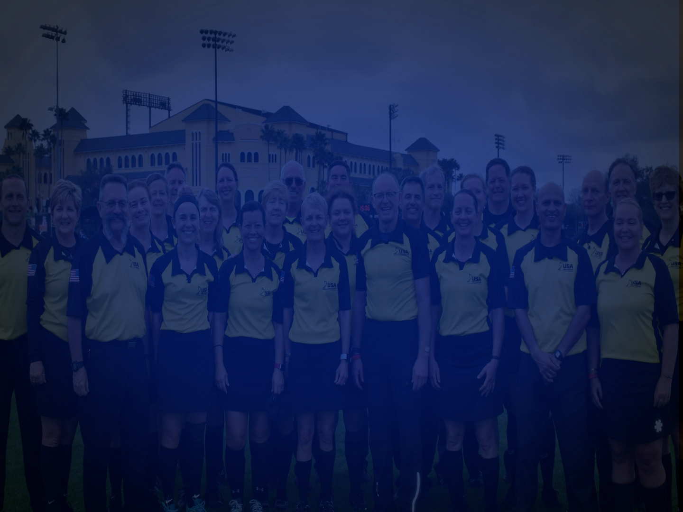

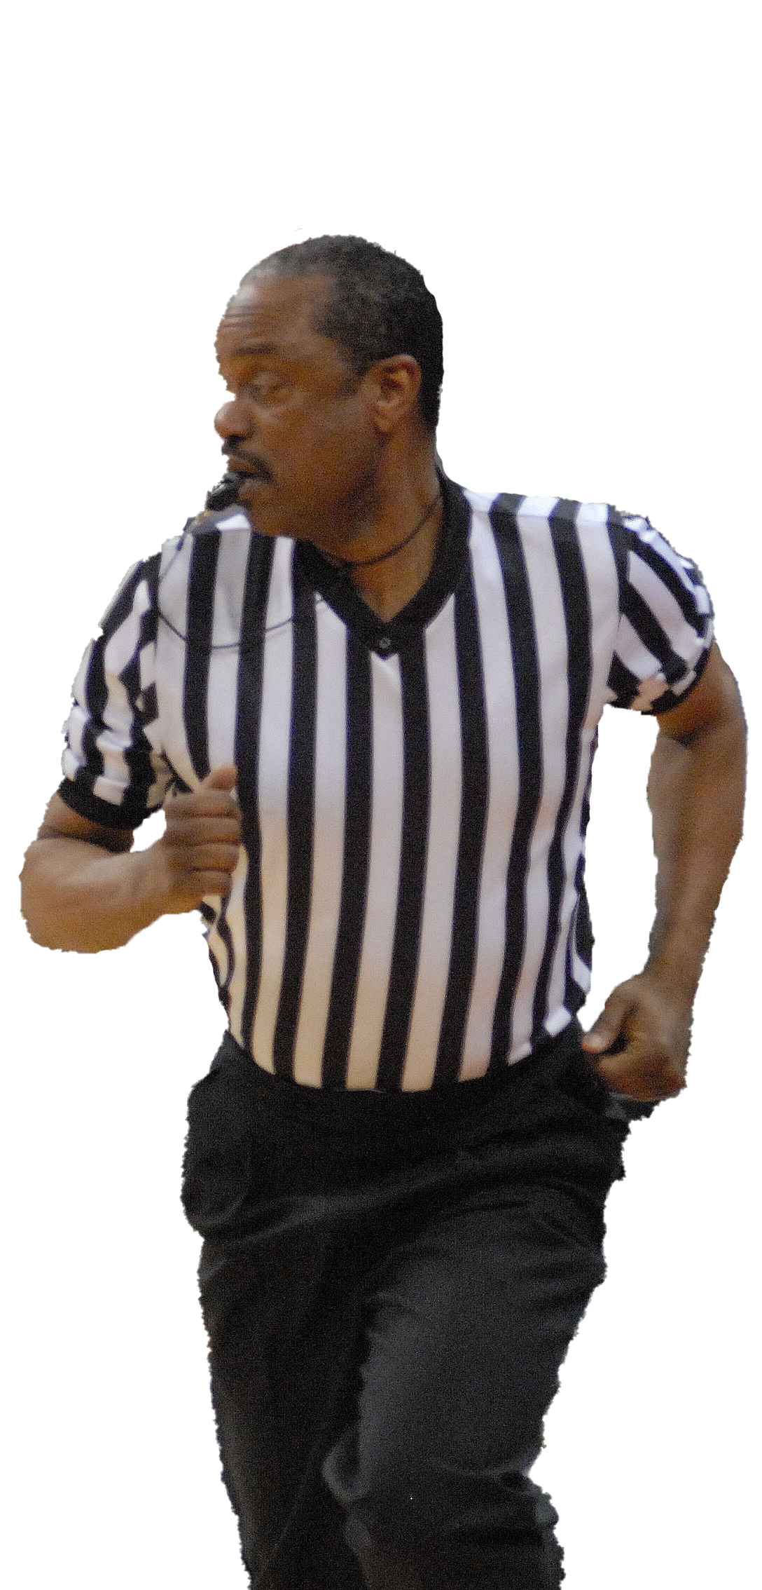




OFFICIALS EDUCATION
CONTENT IS NOW FREE
TEACHING AIDS
RULES
CHANGES
VIDEO
LIBRARY
OFFICIALS
COURSES
DIAGRAMS
Notes:
Sport-Specific Officiating courses are offered in several sports. They are ideal for new officials and those in the first few years of officiating. These courses introduce officials to the mechanics and techniques used in the sport and provide specific information on an area within that sport. Individuals can complete a course within 30-45 minutes. These courses are free to all officials and prospective officials.
“Interscholastic Officiating” is a general course on sports officiating, and it is free to all officials and prospective officials. This course provides an introduction to skills and concepts used as an official. Several topics are covered such as: basics of becoming and staying an official, science of officiating, art of officiating, how to combine these skills for successful officiating.
Video clips are made available to NFHS Officials Association members. The video is clipped on specific topics and provides the rules references as well as dialogue on the topic.
The courses and videos are offered at www.NFHSLearn.com .
Courses Available:
Officiating Football
Officiating Volleyball – Ball Handling
Officiating Volleyball – Alignment
Officiating Volleyball – E-Whistle
Officiating Basketball
Officiating Basketball – Three-Person Mechanics
Officiating Basketball - Pre-Game Conference
Soccer – Fouls and Misconduct
Soccer – Offside
Soccer - Pre-Game Conference
Swimming and Diving
Officiating Wrestling
Umpiring Softball
Officiating Field Hockey
Officiating Track and Field
Future Courses to be Considered:
Umpiring Baseball
Umpiring Softball – 2 Person Mechanics
Communication Among Officials and Coaches

Slide 66

Notes:
NFHS CENTER FOR OFFICIALS SERVICES (COS)
Your Complete Solution for Officials Management and More:
Registration
Assignment
Payment
Testing
Background Checks
For More Information on the NFHS – Center for Officials Services (COS) Contact:
Theresia Wynns, Director of Sports and Officials, twynns@nfhs.org
Also If You’re Interested in Eligibility and Monitoring Requirements Contact the Folks at Dragonfly:
Kirk Miller, Dragonfly, kirk@dragonflyathletics.com
Brandon Wallace, Dragonfly, brandon@dragonflyathletics.com

Slide 67
NFHS Learning Center
Notes:
NFHS LEARNING CENTER

Slide 68

Notes:
The NFHS Learning Center can be accessed at www.nfhslearn.com. It has over 80 online courses and over 50 of those can be accessed at no cost. There are courses for everyone within the interscholastic community including coaches, students, administrators, parents, officials, and individuals within performing arts programs. All courses include a completion certificate and can be accessed 24 hours a day, 7 days a week and completed at the learner’s pace. Get your community involved in professional development today at the NFHS Learning Center!

Slide 69
NFHS Network
Notes:
NFHS NETWORK

Slide 70
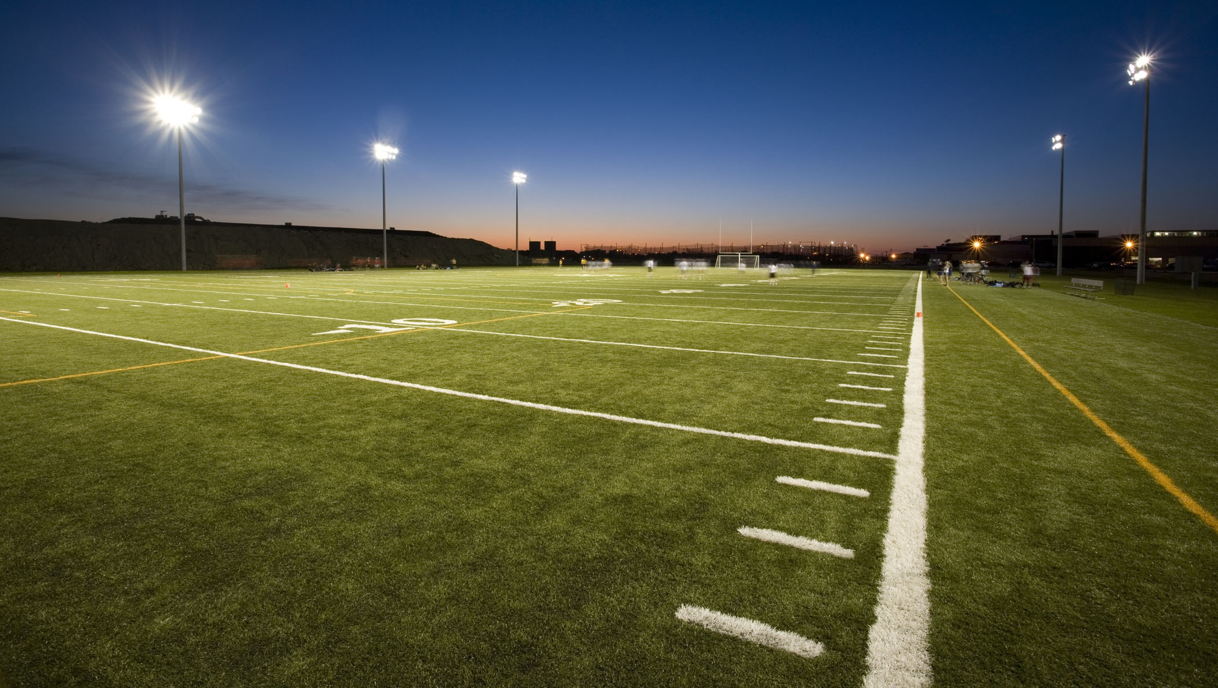

NFHS Network
By 2025, every high school sporting event in America will be streamed live.
The NFHS Network will be THE DESTINATION for fans to view these broadcasts.
27 Different Sports and Activities
www.NFHSnetwork.com
Notes:
The NFHS Network is the leader in streaming Live and On Demand high school sports.
Partnered with the National Federation of State High School Associations, 45 high school state athletic/activities associations, and PlayOn! Sports, the NFHS Network is a joint venture created to provide fans with the ability to stream high school sports on any device, from wherever they are.
All NFHS Network events are available to watch online at www.NFHSnetwork.com and through the NFHS Network Live App for iOS and Android. Follow us on Facebook, Twitter, Instagram, and YouTube.
Watching high school sports and events has never been easier.
The NFHS Network’s goal to broadcast live all 2 million high school sporting events by 2025.
The NFHS Network covers 27 different regular season and postseason sports, as well as other high school activities, celebrating the accomplishments of students-athletes, student broadcasters, and high schools across the country.

Slide 71
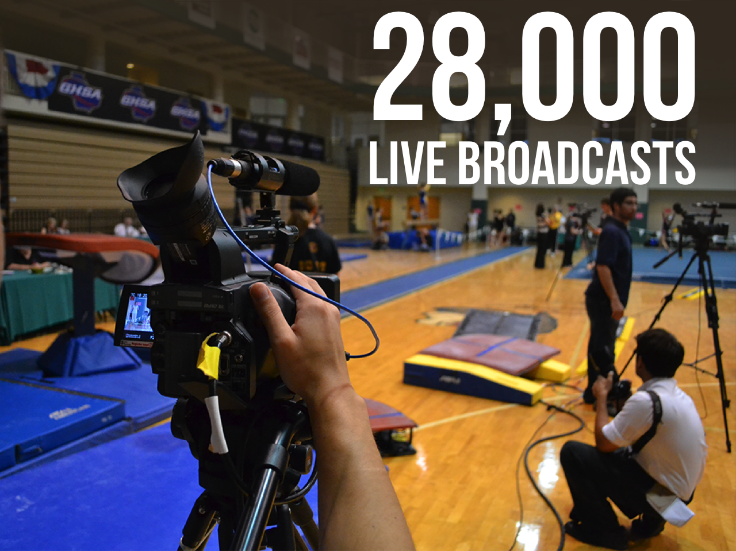
Notes:
The NFHS Network will broadcast over 150,000 live events this year. If your school is not a member of the NFHS Network School Broadcast Program, please contact us at Mark.Koski@NFHSnetwork.com

Slide 72
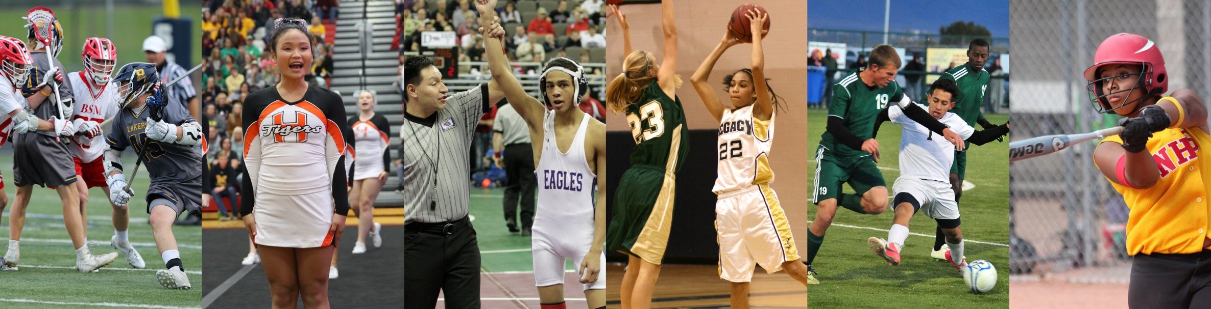
Thank You
National Federation of State High School Associations PO Box 690 | Indianapolis, IN 46206 Phone: 317-972-6900 | Fax: 317.822.5700 www.nfhs.org | www.nfhslearn.com | www.nfhsnetwork.com
Notes:
Thank You
National Federation of State High School Associations PO Box 690 | Indianapolis, IN 46206 Phone: 317-972-6900 | Fax: 317.822.5700 www.nfhs.org | www.nfhslearn.com | www.nfhsnetwork.com

Slide 73
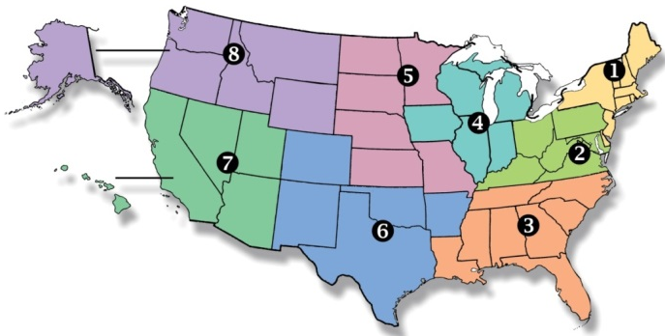
National Federation of State High School Associations
NFHS (located in Indianapolis, IN – Est. 1920):
National leader and advocate for high school athletics and performing arts programs.
Serves 51 state associations, 19,500 high schools and 12 million student participants.
Writes playing rules for 17 high school sports for boys and girls.
Offers online education courses for high school coaches, officials, parents, students and others.
Ensures that students have opportunity to enjoy healthy participation, achievement and good sportsmanship in education-based athletics.
Notes:
NFHS (located in Indianapolis, IN – Est. 1920):
National leader and advocate for high school athletics and performing arts programs.
Serves 51 state associations, 19,500 high schools and 12 million student participants.
Writes playing rules for 17 high school sports for boys and girls.
Offers online education courses for high school coaches, officials, parents, students and others.
Ensures that students have opportunity to enjoy healthy participation, achievement and good sportsmanship in education-based athletics.

Slide 74



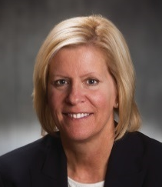
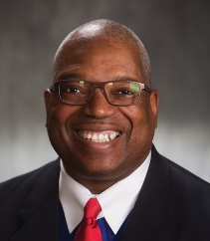
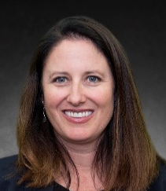


NFHS Rules Review Committee
The NFHS Rules Review Committee is chaired by the chief operating officer and composed of all rules editors. After each committee concludes its deliberations and has adopted its recommended changes for the subsequent year, such revisions will be evaluated by the Rules Review Committee.
Davis Whitfield
Chief Operating Officer
Lindsey Atkinson
Girls Lacrosse and Volleyball
Bob Colgate
Football and Sports
Medicine
Sandy Searcy
Softball, Swimming & Diving and Water Polo
Elliot Hopkins
Baseball and Wrestling
Julie Cochran
Cross Country, Gymnastics, Field Hockey and
Track & Field
James Weaver
Boys Lacrosse
and Spirit
Theresia Wynns
Basketball and Soccer
Dan Schuster
Ice Hockey
Notes:
The NFHS Rules Review Committee is chaired by the chief operating officer and composed of all rules editors. After each committee concludes its deliberations and has adopted its recommended changes for the subsequent year, such revisions will be evaluated by the Rules Review Committee.

Slide 75



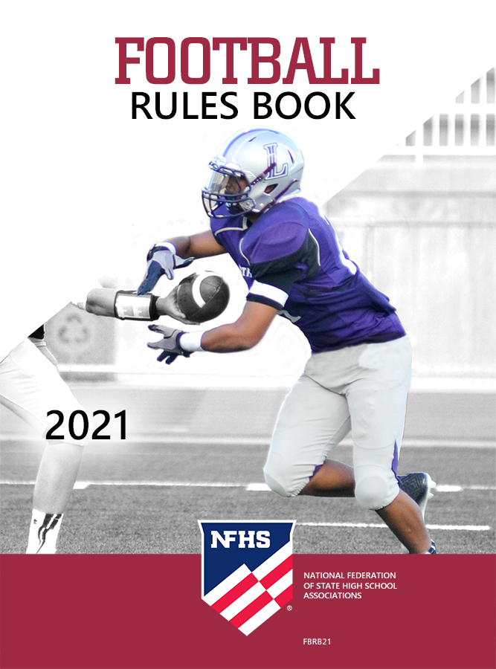
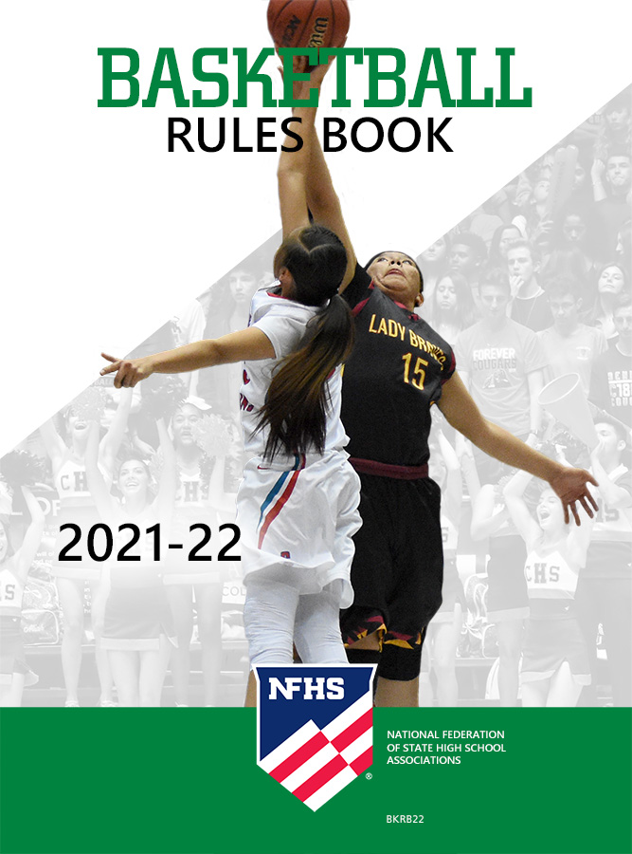


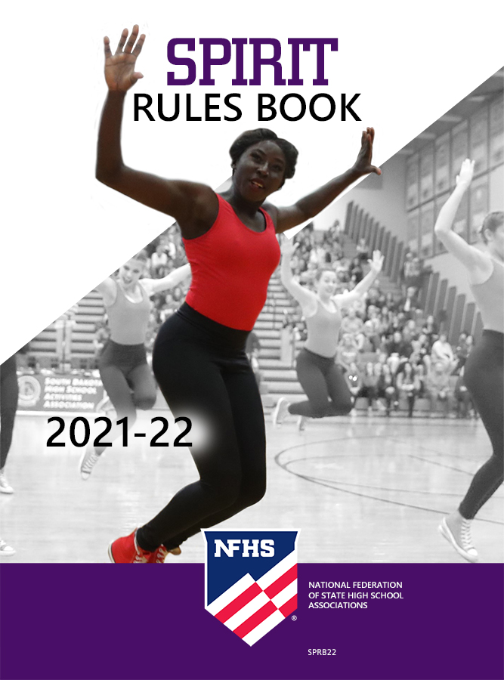

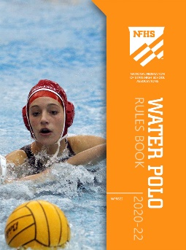
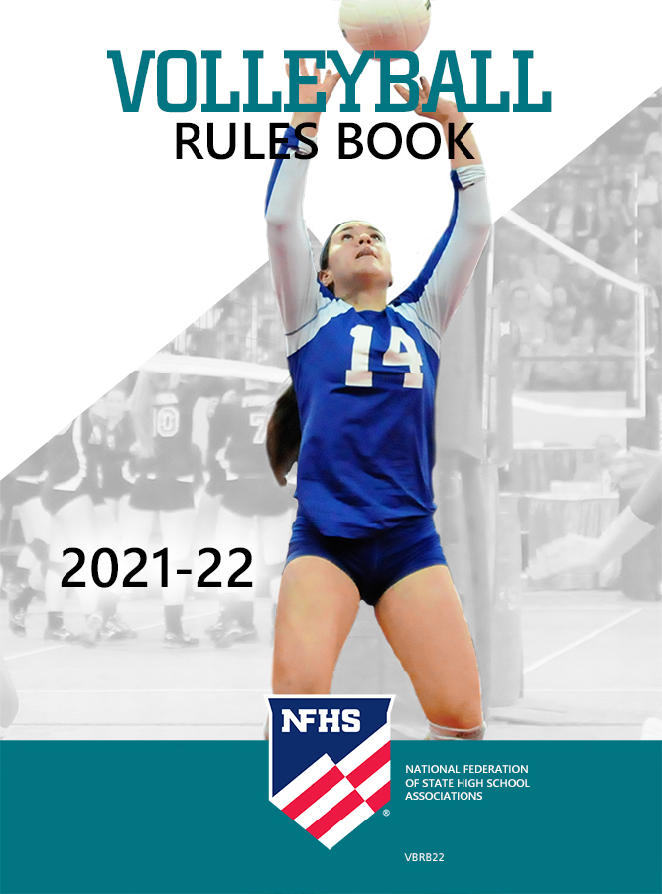
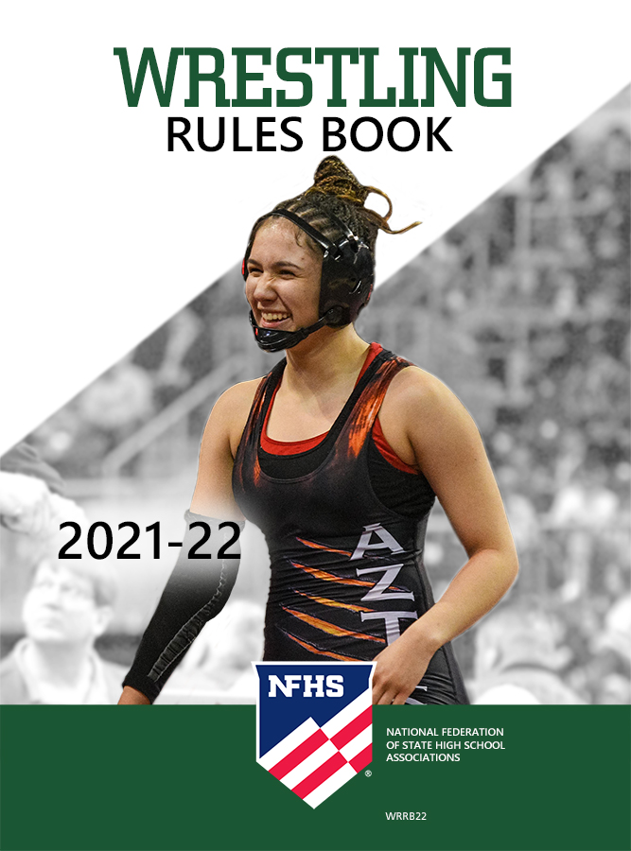

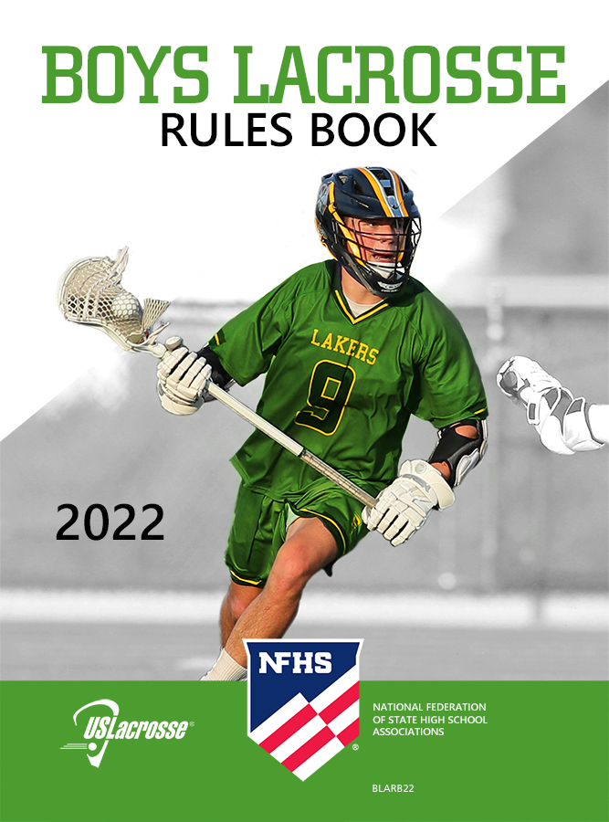
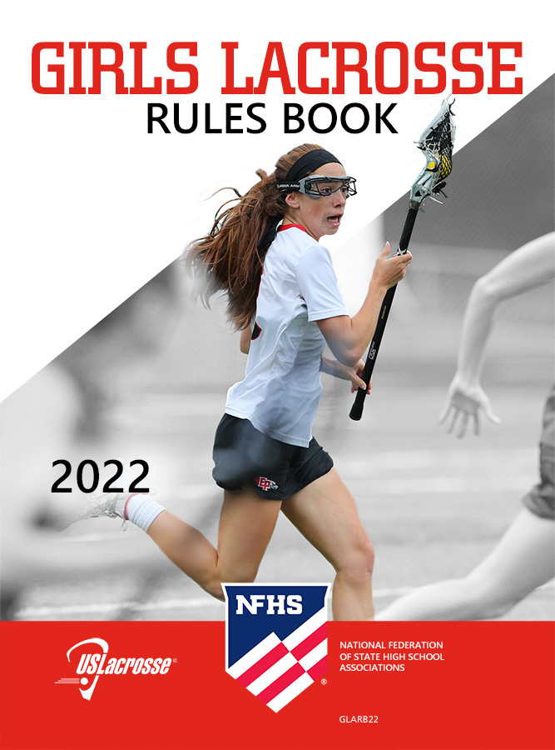
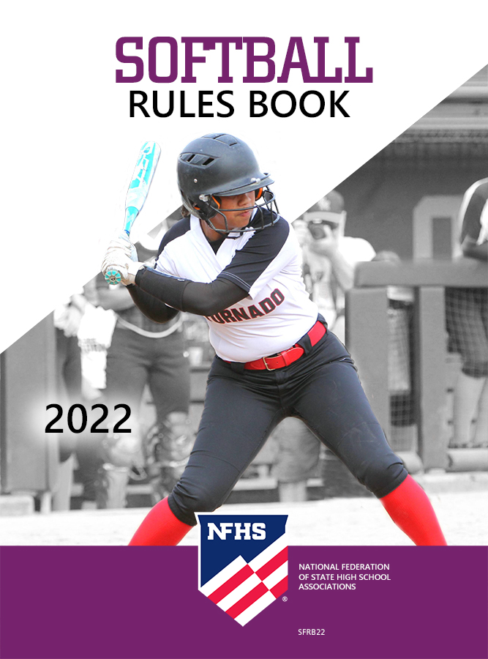

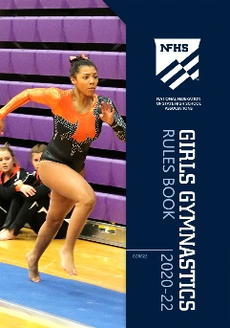
National Federation of State High School Associations
The NFHS writes playing rules for 17 sports for boys and girls at the high school level.
Publishes 4 million pieces of materials annually.
Notes:
The NFHS writes playing rules for 17 sports for boys and girls at the high school level.
Publishes 4 million pieces of materials annually.

Slide 76

NFHS Rules Book as e-Books
E-books features:
Searchable
Highlight areas of interest
Make notes
Easy navigation
Adjustable viewing size
Immediate availability
Notes:
E-books features:
Searchable
Highlight areas of interest
Make notes
Easy navigation
Adjustable viewing size
Immediate availability

Slide 77
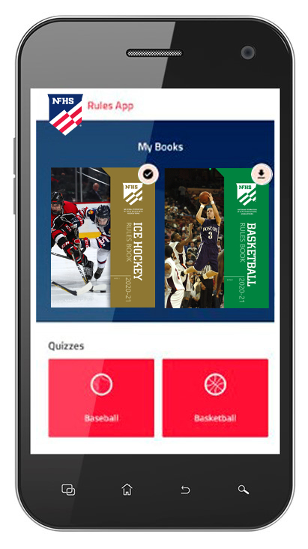
NEW NFHS Rules App
Rules App features:
Searchable
Highlight notes
Bookmarks
Quizzes for all sports
Easy navigation
Immediate availability
Free to paid members of the NFHS Coaches and Officials Associations
www.nfhs.org/erules for more information
Notes:
Rules App features:
Searchable
Highlight notes
Bookmarks
Quizzes for all sports
Easy navigation
Immediate availability
Free to paid members of the NFHS Coaches and Officials Associations
www.nfhs.org/erules for more information

Slide 78

Sponsor Slide
remove this text and place artwork centered here
Notes:
BISON – THE EXCLUSIVE PARTNER FOR THE SPORT OF BASKETBALL

Slide 79
2021-2022
NFHS BASKETBALL RULES REMINDER
Notes:
2020-21 NFHS BASKETBALL RULES REMINDER

Slide 80
DATES TO BE AWARE
Online Rules Interpretation Meeting – Thursday, September 23, 2021, 2:00 EDT
Mid-Season Webinar – Thursday, January 13, 2022, 2:00 EST
New Basketball Rules Proposals Due - March 1, 2022
Basketball Rules Committee Meeting – April 11 - 13, 2022
Notes:
IMPORANT DATES
Online Rules Interpretation Meeting – Thursday, September 23, 2021, 2:00 EDT
Mid-Season Webinar – Thursday, January 13, 2022, 2:00 EST
New Basketball Rules Proposals Due - March 1, 2022
Basketball Rules Committee Meeting – April 11 – 13, 2022

